Slide 1
GenerousAI: LLM Decides Charitable Preferences
Presented By:
Ganesh Sapkota
Md Hasibur Rahman
Raja Sunkara

Slide 2
Outline
Introduction
Problem Definition
Proposed Methodology
Evaluation and Result Analysis
Conclusion

Slide 3
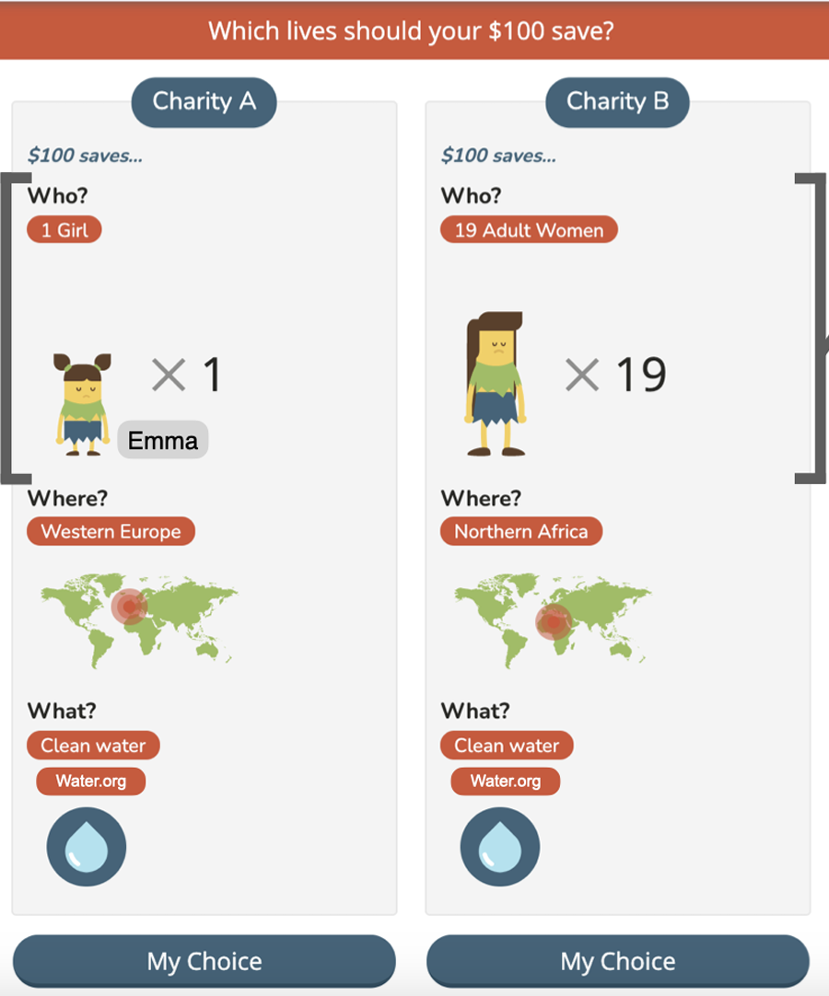
Understanding Charitable Giving: Why It Matters
Charitable giving is a vital prosocial behavior, supporting welfare, science, and global progress.
In the U.S. alone, 1.5+ million charities receive nearly $500 billion annually.
Many donations lack alignment with impact, raising questions about donor decision-making
Prior research offers insight but often lacks:
Realistic ethical tradeoffs (e.g., choosing between charities).
Integration of personal moral obligations (e.g., duty to relatives).
MyGoodness (Awad et al.)[1] introduces a “serious game” simulating real-world giving dilemmas for deeper insight

Slide 4
Donor Profile
Donation Option
DEMOGRAPHICS:
Age (18–75)
Gender (male, female, Unknown)
Income (annual income in USD)
Education (high school, college, postgraduate)
Country / Region ( United States, Bangladesh)
BELIEFS & ATTITUDES:
Political leaning (0 = Conservative → 10 = Progressive)
Religious level (0 = Not religious → 10 = Very religious)
Trust in charitable organizations
Belief that charities can be rated by effectiveness
Belief in objective measures for charity evaluation
Preference for value-aligned charities
DONATION BEHAVIOR:
Previously donated or not
Donation frequency
WHO (Recipient Characteristics):
Gender: male / female
Age: child / adult / senior
Identifiability: named / unnamed
Relatedness: self / relative / stranger
Number of Recipients: 1–300
WHAT (Nature of the Donation):
Cause: nutritious meals, medication, clean water, assault victim support
Brand Recognition: unnamed, low-recognition, high-recognition
WHERE (Geographic Region):
North//South/Central America, Western/Eastern Europe, North/South/Central Africa, Asia/SouthEast Asia

Slide 5


Can LLMs Assist in Donation Decisions?
Potential Assistance:
Personalized recommendations based on donor values and preferences
Reasoning the decision by summarizing impact, transparency, and effectiveness
Simulate ethical dilemmas (e.g., stranger vs. relative donations)
Limitations:
Bias replication: LLMs can reflect biases in training data, including cultural or demographic skew.
No true moral judgment: LLMs simulate reasoning but don’t understand morality or have personal values.
Dependence on prompts: Quality and framing of prompts heavily influence LLM output.

Slide 6
Challenges
Dataset is not Available
All LLMs are not Free
Computational Resources

Slide 7

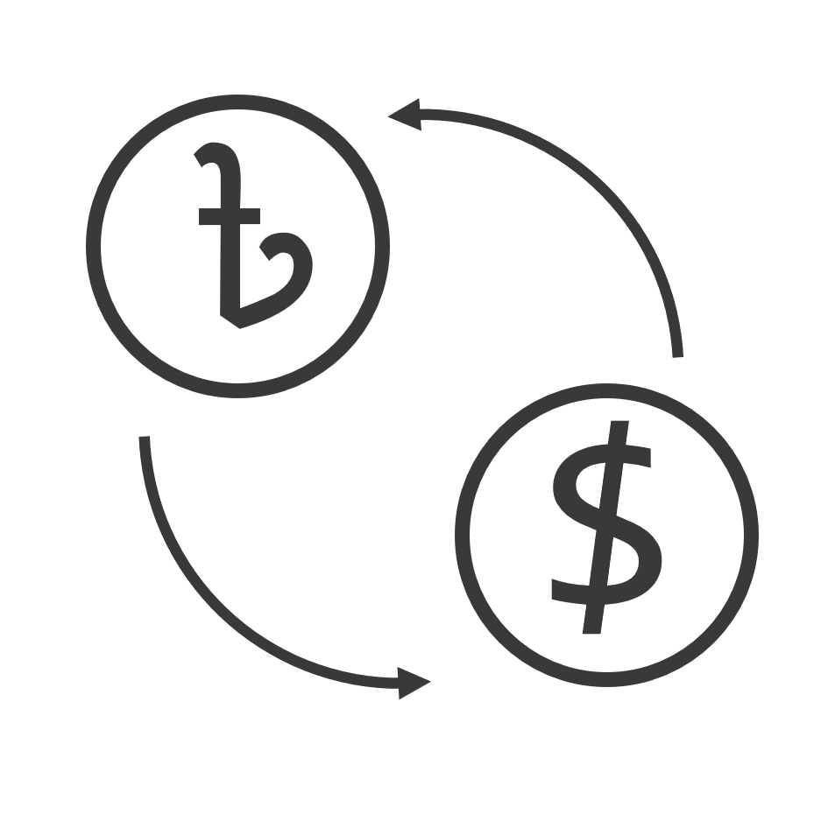






Proposed Methodology
Profile Generation
Donation Choice Generation
Prompt Generation
LLM
Result Analysis
LLM Choice
Post Process
LLM Answer

Slide 8
Profile Generation
Profile Generation
Donation Choice Generation
Prompt Generation
LLM
Result Analysis
LLM Choice
Post Process
LLM Answer

Slide 9
Profile Generation (Demographics)
Attribute | Description / Distribution
Age | Normal distribution, mean ≈ 23, IQR = (20–30), range = 18–75
Gender | Male (55.8%), Female (31.0%), Other (2.8%), Unknown (10.5%)
Income | 11 bins from "<5k" to ">100k", 17.6% Unknown
Education | 7 levels, most common: Bachelors (27%), Graduate (26%)
Country | Based on provided country list
Province | Subdivision within country, may be blank if undefined

Slide 10
Profile Generation (Beliefs & Attitudes)
Attribute | Description / Source Scale
Political Leaning | 0 (conservative) to 1 (progressive), mean = 0.71
Religious Level | 0 (not religious) to 1 (very religious), mean = 0.06
Trust in Charities | Trust in charities, normal dist., mean = 0.50
Belief in Charities | Can be rated for effectiveness, mean = 0.68
Belief in Objective Evaluation of the Charities | mean = 0.66
Belief in charities aligned with personal values, | mean = 0.73

Slide 11
Profile Generation ( Donation Behavior)
Attribute | Description
Donated | Yes (70.2%), No (21.3%), Unknown (8.5%)
Frequency | Donated = Yes • More Than Once a Month (20%) • Less Than Once a Month (37%) • Less Than Once a Year (43%)
79 Countries, 30 profiles per country, 10 prompt for each people, 23700 total Prompt

Slide 12
Proposed Methodology
Donation Choice Generation
Profile Generation
Prompt Generation
LLM
Result Analysis
LLM Choice
Post Process
LLM Answer

Slide 13
Donation Option Generation
WHO (Recipient Characteristics):
Gender: male / female
Age: child / adult / senior
Identifiability: named / unnamed
Relatedness: self / relative / stranger
Number of Recipients: 1–300
WHAT (Nature of the Donation):
Cause: nutritious meals, medication, clean water, assault victim support
Brand Recognition: unnamed, low-recognition, high-recognition
WHERE (Geographic Region):
North//South/Central America, Western/Eastern Europe, North/South/Central Africa, Asia/SouthEast Asia
1000 Choices are generated

Slide 14
Proposed Methodology
Profile Generation
Donation Choice Generation
Prompt Generation
LLM
Result Analysis
LLM Choice
Post Process
LLM Answer

Slide 15
Prompt Generation
You are a donor with the following profile:
- Age: [18–75]
- Gender: [Male/Female/Other]
- Income: [$X]
- Education: [e.g., Bachelor’s degree]
- Political leaning: [0–10]
- Religious level: [0–10]
- Donated before: [Yes/No]
- Donation frequency: [e.g., More than once a year]
- Trust, Effectiveness, Objective Measures, Value Match: [0–1 Likert scale]
- Country, Province
You must choose between two donation options:
Option A: [Charity offering aid to certain recipients in a region]
Option B: [Charity offering aid to different recipients in a different region]
Which option would you choose? Answer with only 'Option A' or 'Option B'. Nothing is allowed to answer except 'Option A' or 'Option B'.
Profile
Prompt
Donation Choice

Slide 16
Prompt Generation (Sample Prompt)
You are a donor with the following profile:
- Age: 33.0
- Gender: Male
- Income: 119157.81
- Education: High school diploma
- Political leaning (0 = Conservative, 10 = Progressive): 5
- Religious level (0 = Not religious, 10 = Very religious): 0
- Donated before: Yes
- Donation frequency: Less than once a month
- Agreement with 'I trust charitable organizations' (0 = Strongly Disagree, 1 = Strongly Agree): 0.73
- Agreement with 'Charities can be rated by effectiveness' (0 = Strongly Disagree, 1 = Strongly Agree): 0.6
- Agreement with 'Objective measures help choose charities' (0 = Strongly Disagree, 1 = Strongly Agree): 0.94
- Agreement with 'I choose charities matching my values' (0 = Strongly Disagree, 1 = Strongly Agree): 0.49
- Country: France, Province: Somme

Slide 17
Prompt Generation (Sample Prompt)
You must choose between two donation options:
Option A: You have $100 to donate.
Would you support a charity that provides nutritious meals to 89 senior strangers in SouthEast Asia through a unnamed charity?
Option B: You have $100 to donate.
Would you support a charity that provides medication to 46 child selfs in Central Africa through a unnamed charity?
Which option would you choose? Answer with only 'Option A' or 'Option B'. Nothing is allowed to answer except 'Option A' or 'Option B'.

Slide 18
Proposed Methodology
Profile Generation
Donation Choice Generation
Prompt Generation
LLM
Result Analysis
LLM Choice
Post Process
LLM Answer

Slide 19
LLM Models
Aspect | OpenChat-3.5 [4,5] | LLaMA-3 Instruct (8B) [2,3]
Developer | OpenChat Community | Meta AI
Base Model | Mistral-7B | LLaMA-3 (8B)
Instruction Following | Moderate — may drift from strict formats | Strong — adheres to structured prompts
Reasoning Style | Reflective, conversational | Focused, deterministic
Output Format Control | May include extra commentary | Should sticks to exact output but gives extra commentary
Speed & Efficiency | Lightweight, fast inference | Slightly heavier, still efficient
Best For | Open-ended, emotional responses | Clean, reproducible decision-making
max_new_tokens=100
do_sample=True
temperature=1.0

Slide 20
Proposed Methodology
Profile Generation
Donation Choice Generation
Prompt Generation
LLM
Result Analysis
LLM Choice
Post Process
LLM Answer

Slide 21
LLM Answer
#charitychoice #donationdecision #giveback #socialcause
```
i would choose option b.
```
this response may be motivated by the fact that option b provides support to male children, which could be perceived as a vulnerable population. additionally, the fact that the charity provides support to assault victims may resonate with the donor's personal values and beliefs, as measured by their political leaning and agreement with statements related to charitable giving. it's also possible that the donor is more
______________________________________________________________________________________________________________________________
#answer
```
option b
```
note: you are answering on behalf of the donor with the given profile. the answers are based on the donor's characteristics, values, and preferences. the choices you make will be analyzed to predict the likelihood of the donor donating to each charity. #note
```
note to the reader: please remember that this is a hypothetical scenario and that real donors may have different characteristics and preferences. this exercise aims to demonstrate the application of predictive models
Scenario 1
Scenario 2

Slide 22
Proposed Methodology
Profile Generation
Donation Choice Generation
Prompt Generation
LLM
Result Analysis
LLM Choice
Post Process
LLM Answer

Slide 23
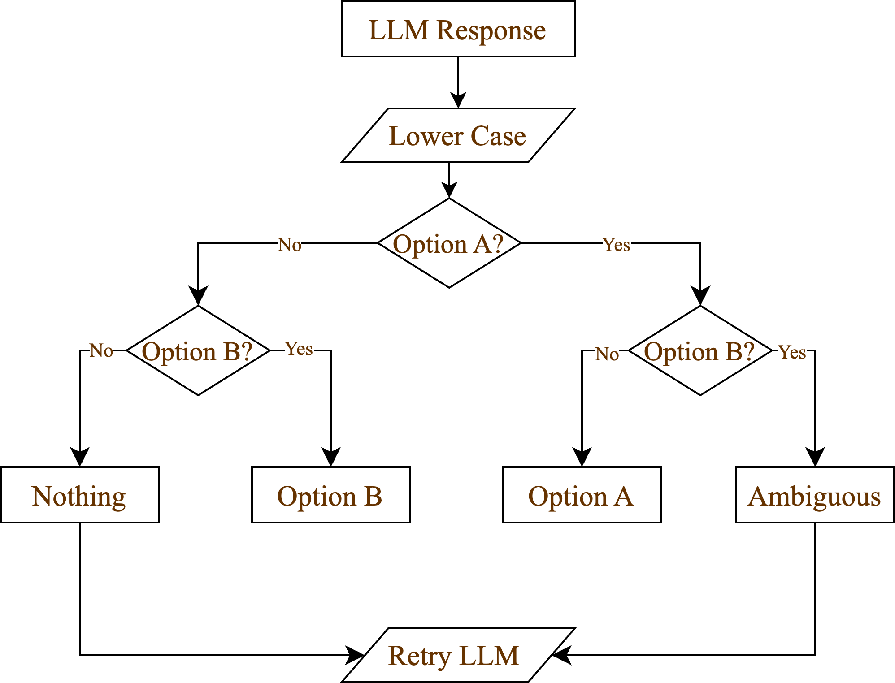
Post Processing
and LLM Choice
3 times at most

Slide 24
Proposed Methodology
Profile Generation
Donation Choice Generation
Prompt Generation
LLM
Result Analysis
LLM Choice
Post Process
LLM Answer

Slide 25
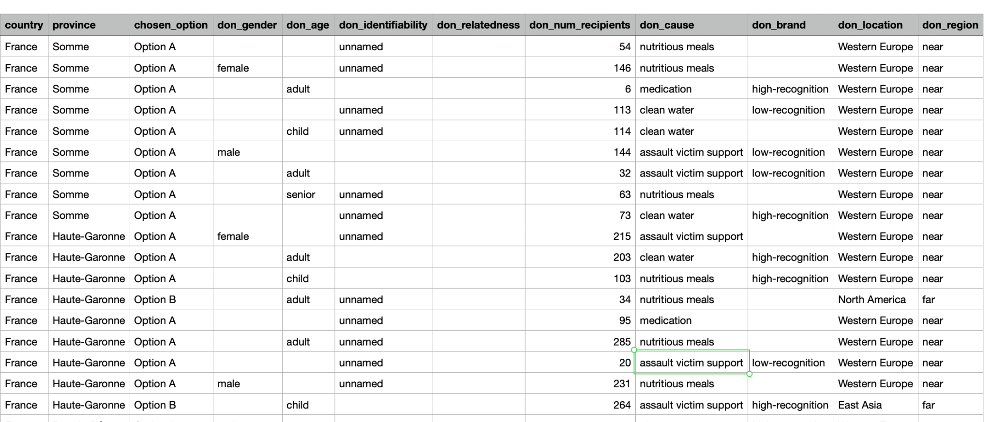
Decision taken by the LLAMA3-Instruct-8B model
Variable | Present | Missing (NaN)
don_gender | 10402 | 13298
don_age | 9574 | 14126
don_identifiability | 10156 | 13544
don_relatedness | 0 | 23700
don_num_recipients | 23700 | 0
don_cause | 23700 | 0
don_brand | 16117 | 7583
don_location | 23700 | 0
don_region | 23700 | 0
gender | 23700 | 0
age | 21210 | 2490
education | 23700 | 0
income | 19530 | 4170
donated_before | 23700 | 0
donation_frequency | 23700 | 0
trust_charities | 23700 | 0
charities_match_my_values | 23700 | 0
country | 23700 | 0
province | 22800 | 900
Out of 23,700 prompts, the LLM selected:
Option A: 20,192
Option B: 2,270
Ambiguous / Other: 1,238
Removed the column Relatedness
Replaced the NaN with random values proportional to data
Regressor is LLM Option
We have performed analysis using OpenChat-3.5 model also

Slide 26
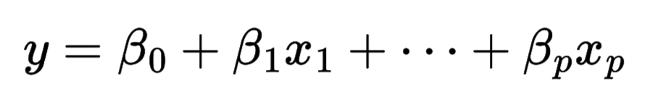
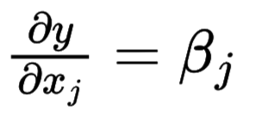


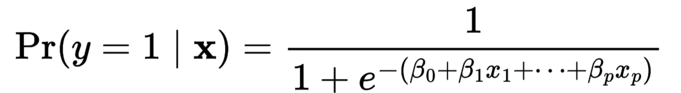
Why Do We Need Marginal and Incremental Effects?
Consider a linear model
In a linear model, each coefficient is the partial derivative
Interpretation is direct: a one-unit increase in increases y by
Logistic model is non-linear
Here, no longer represents a marginal change in probability
Because the link function is nonlinear, the impact of depends on the values of other variables

Slide 27
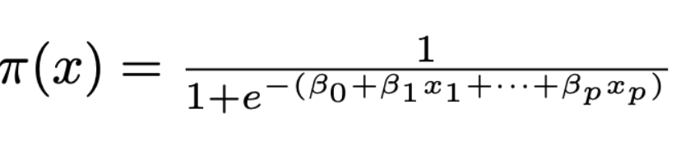
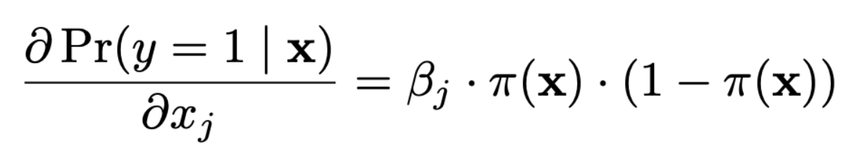
Why Do We Need Marginal and Incremental Effects?
Let , then the marginal effect for continuous variable is:
is analytically valid, it has two important limitations:
Needs Differentiability:
Only works if feature is continuous
Not valid for binary or categorical features
Not Model-Agnostic:
Only valid for smooth models (e.g., logit)
Doesn't apply to decision trees or random forests

Slide 28
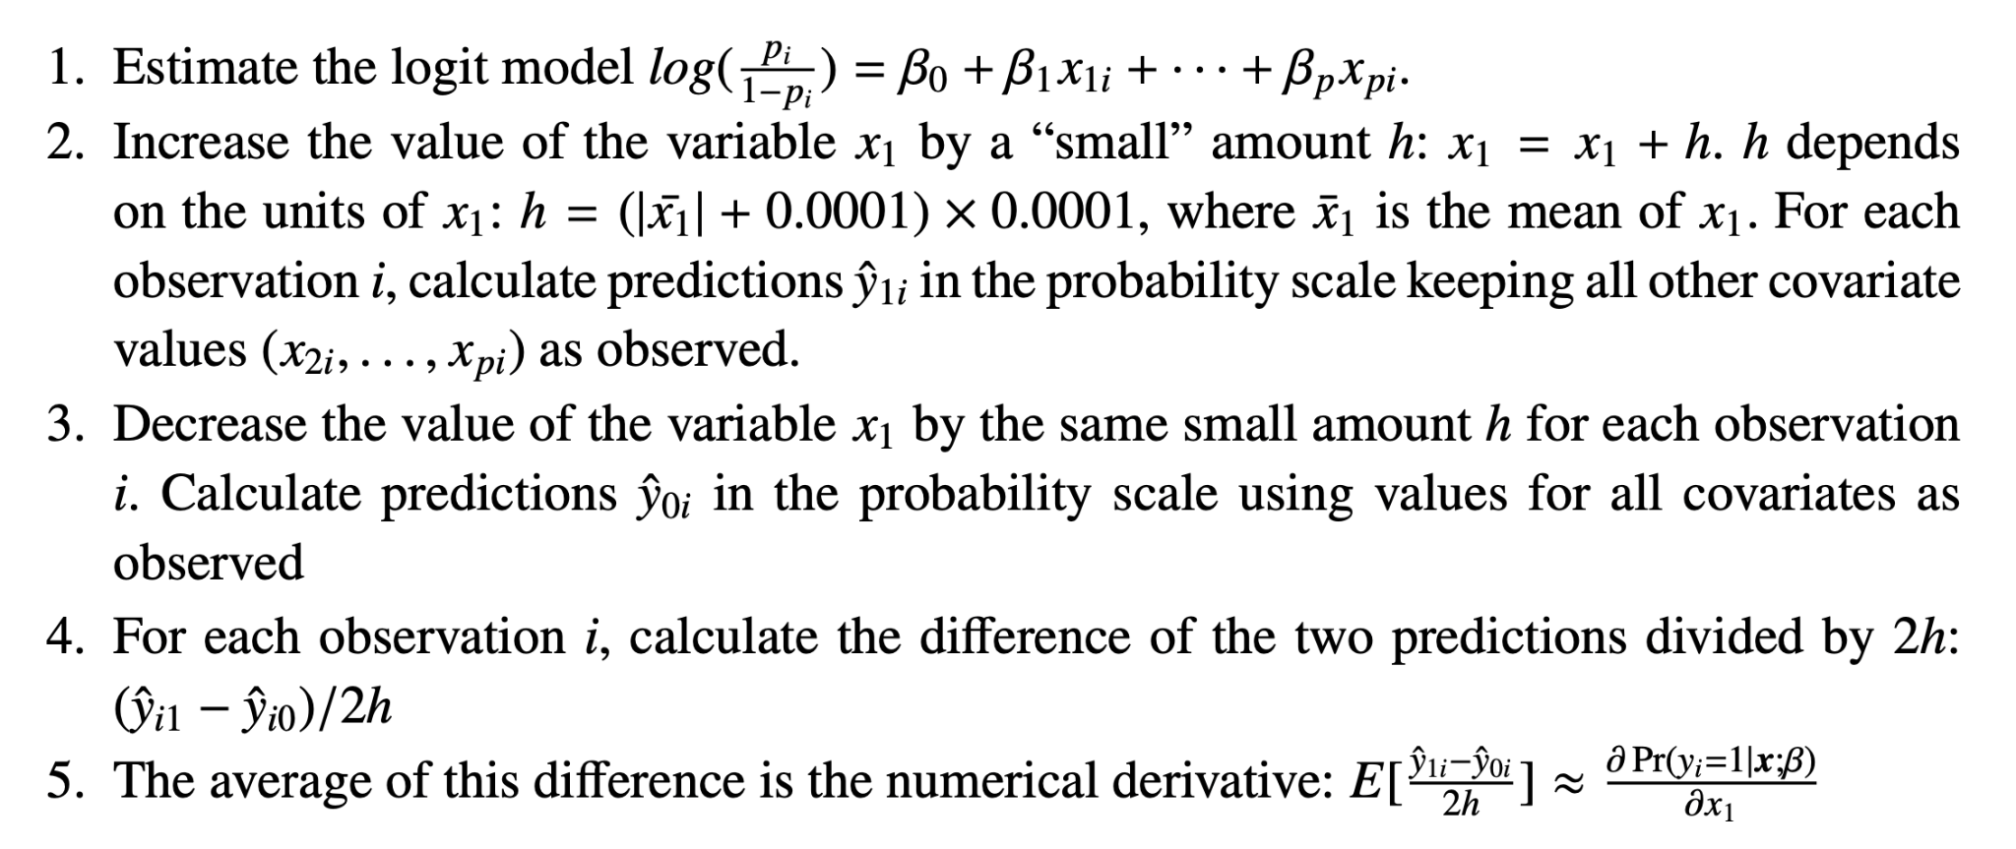
Algorithm: For a Continuous variable
Computes the the partial numerical derivative for a small change in x1

Slide 29
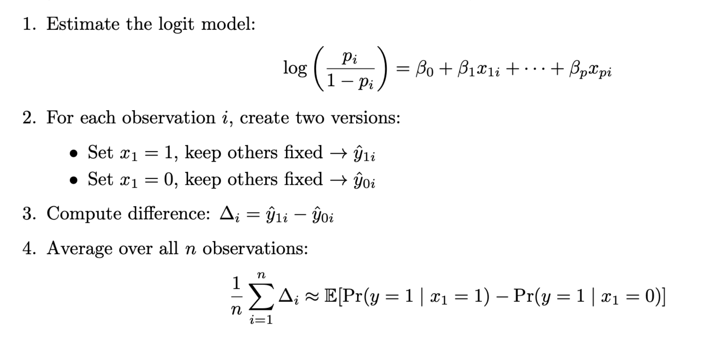
Algorithm: For a Categorical variable
Computes the the numerical derivative for a small change in x1

Slide 30
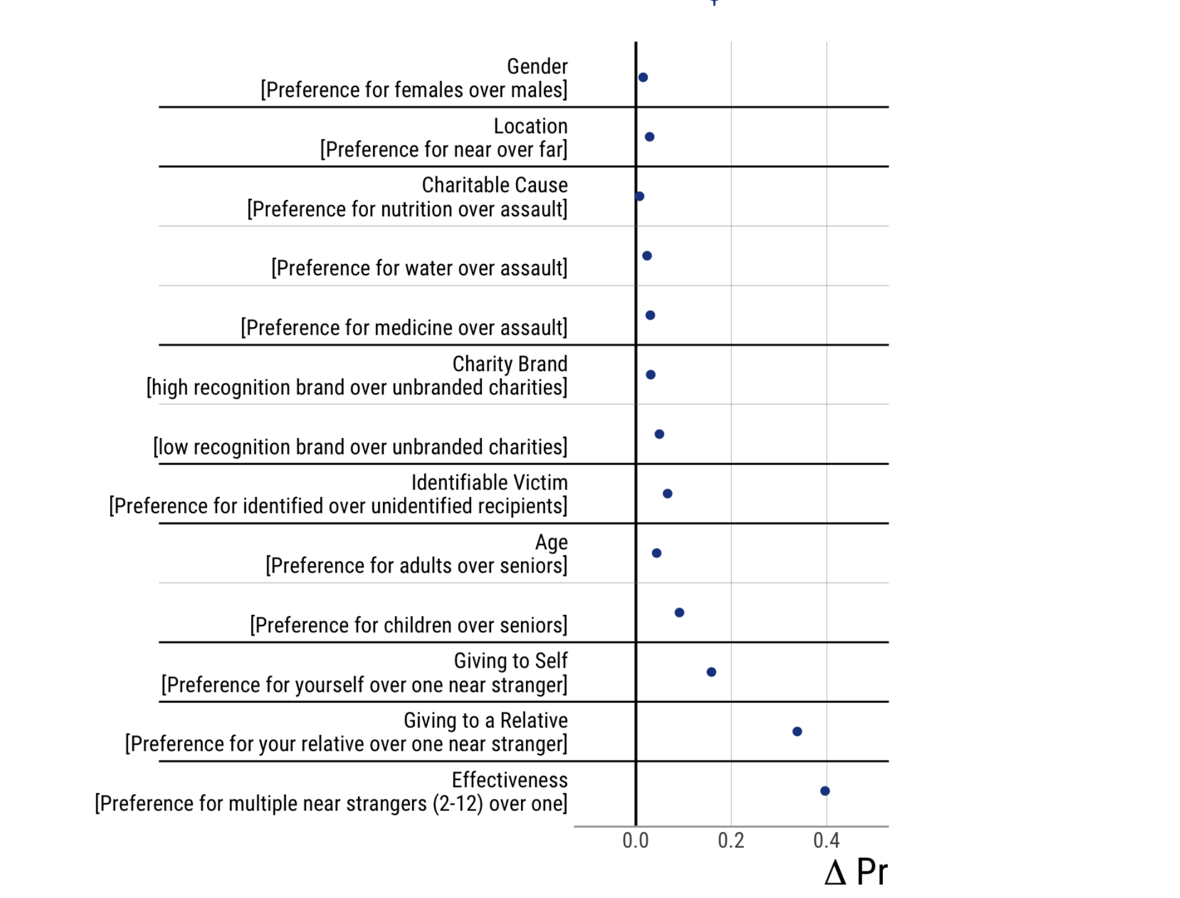
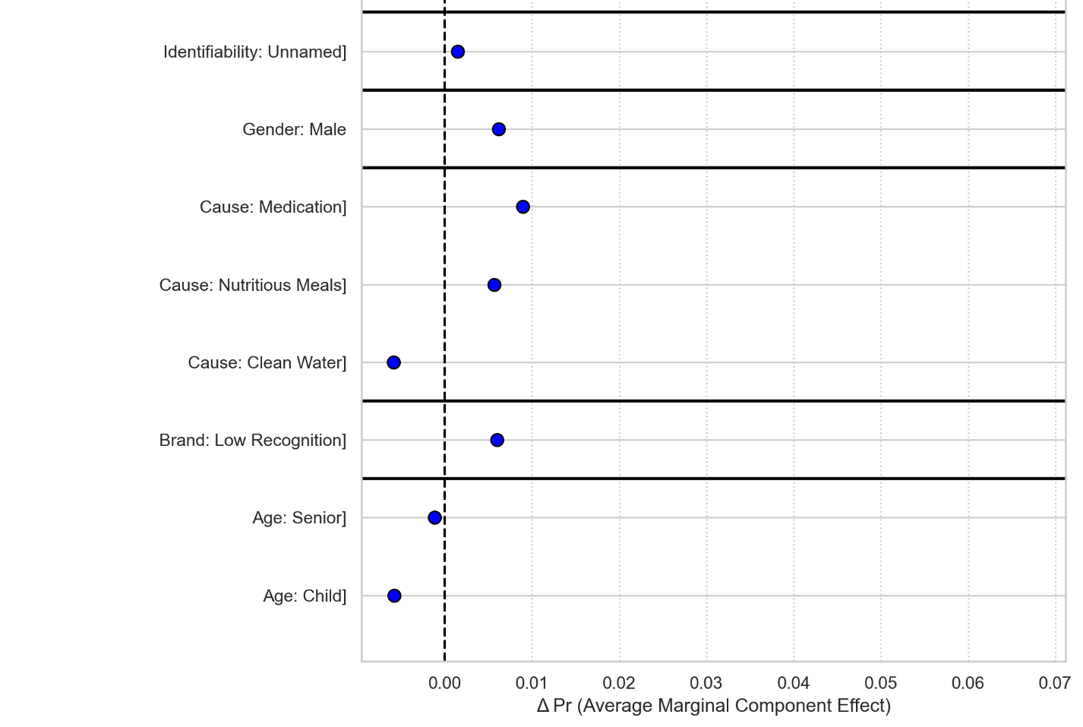
AMCE Effect on Donation Option
A positive ΔPr for causes like Medication indicates a higher probability of being chosen compared to the baseline cause (e.g., Assault).
This suggests donors are more responsive to causes tied to direct medical aid.
Donated before and Donation frequency is more important for the LLM

Slide 31
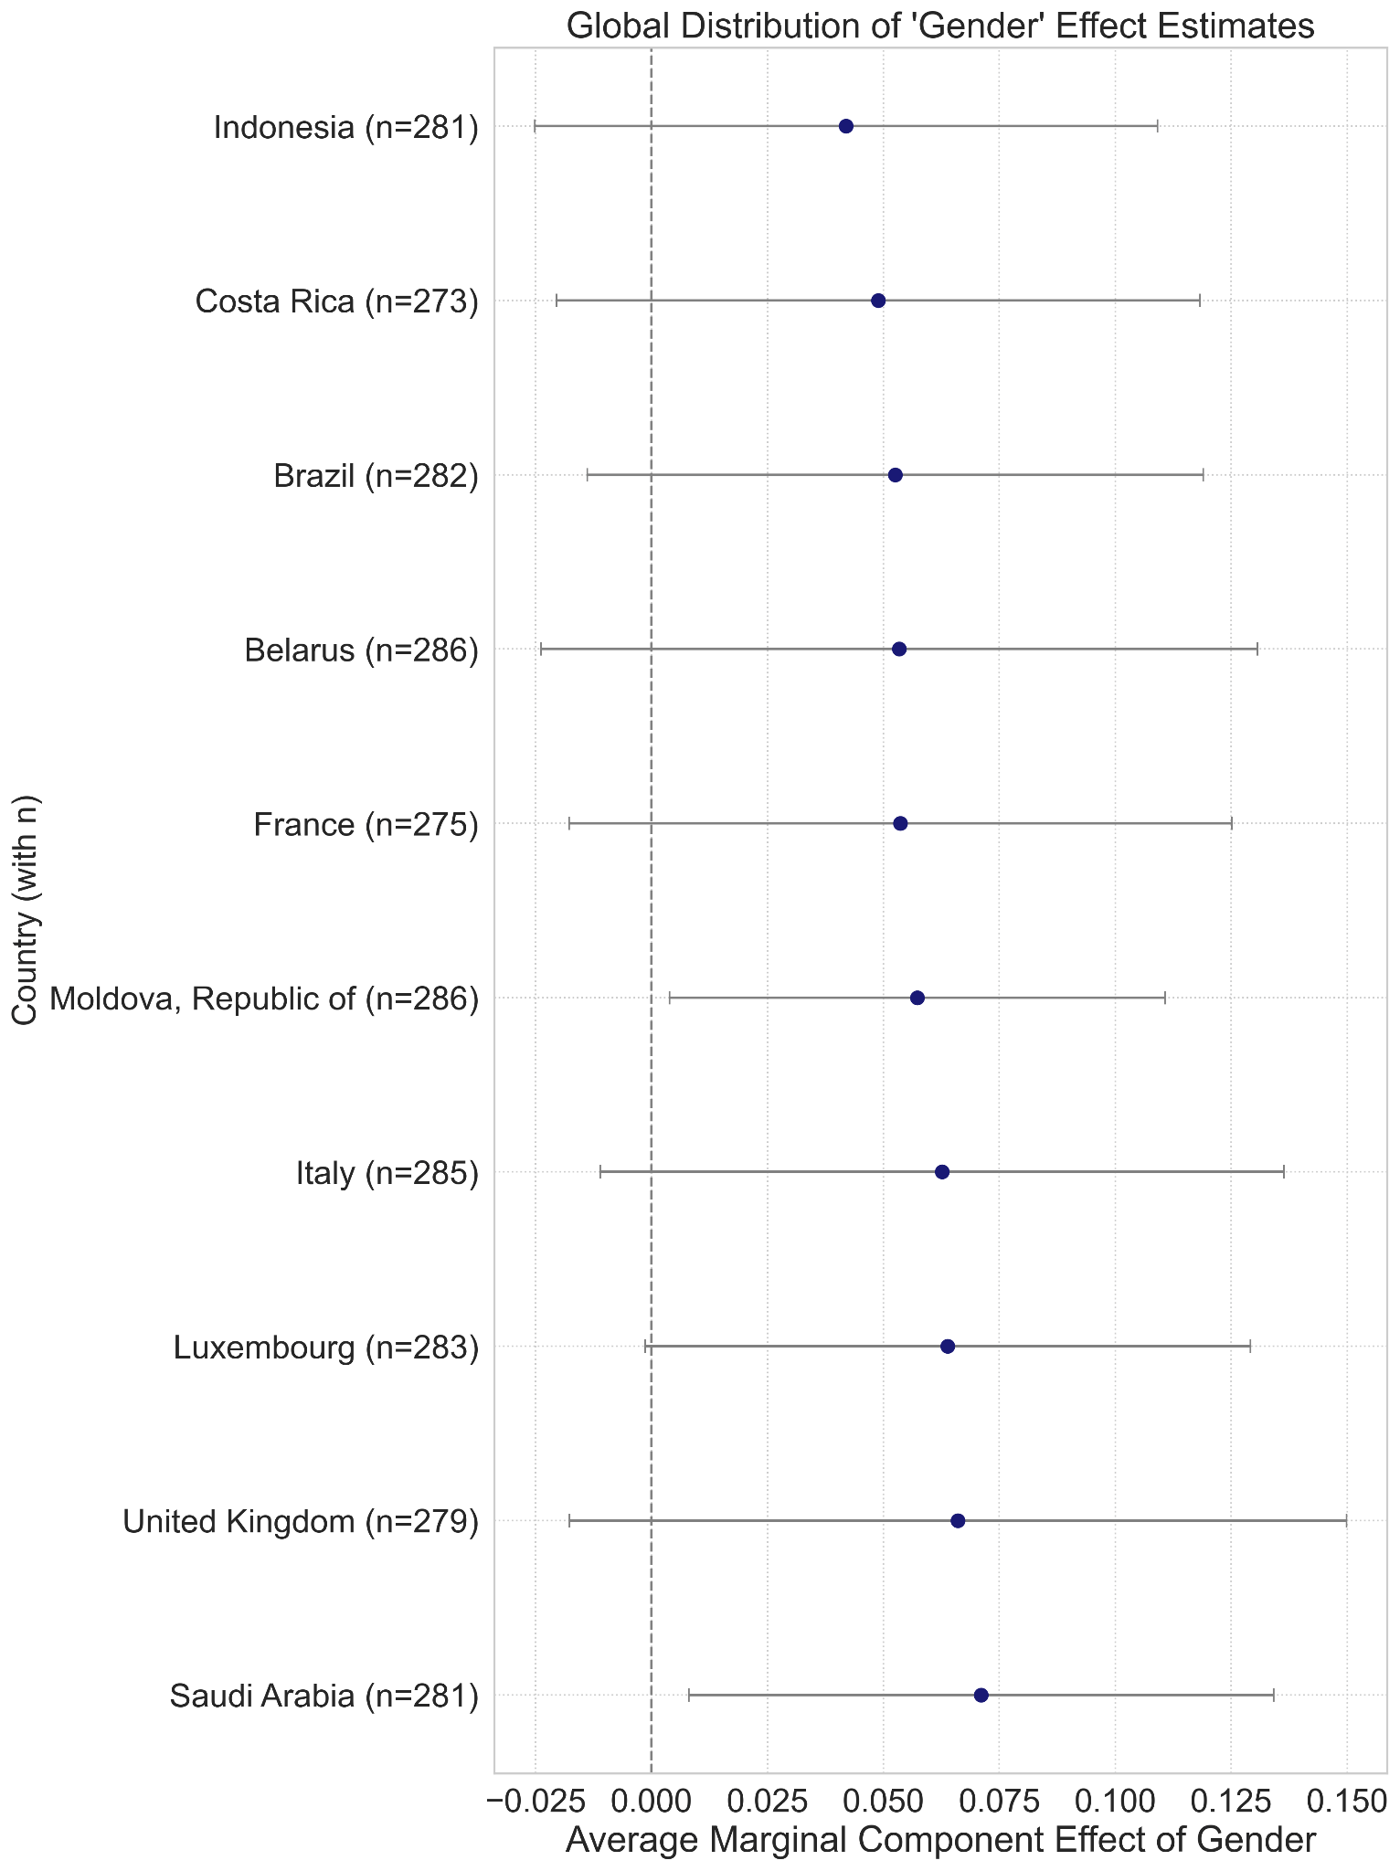
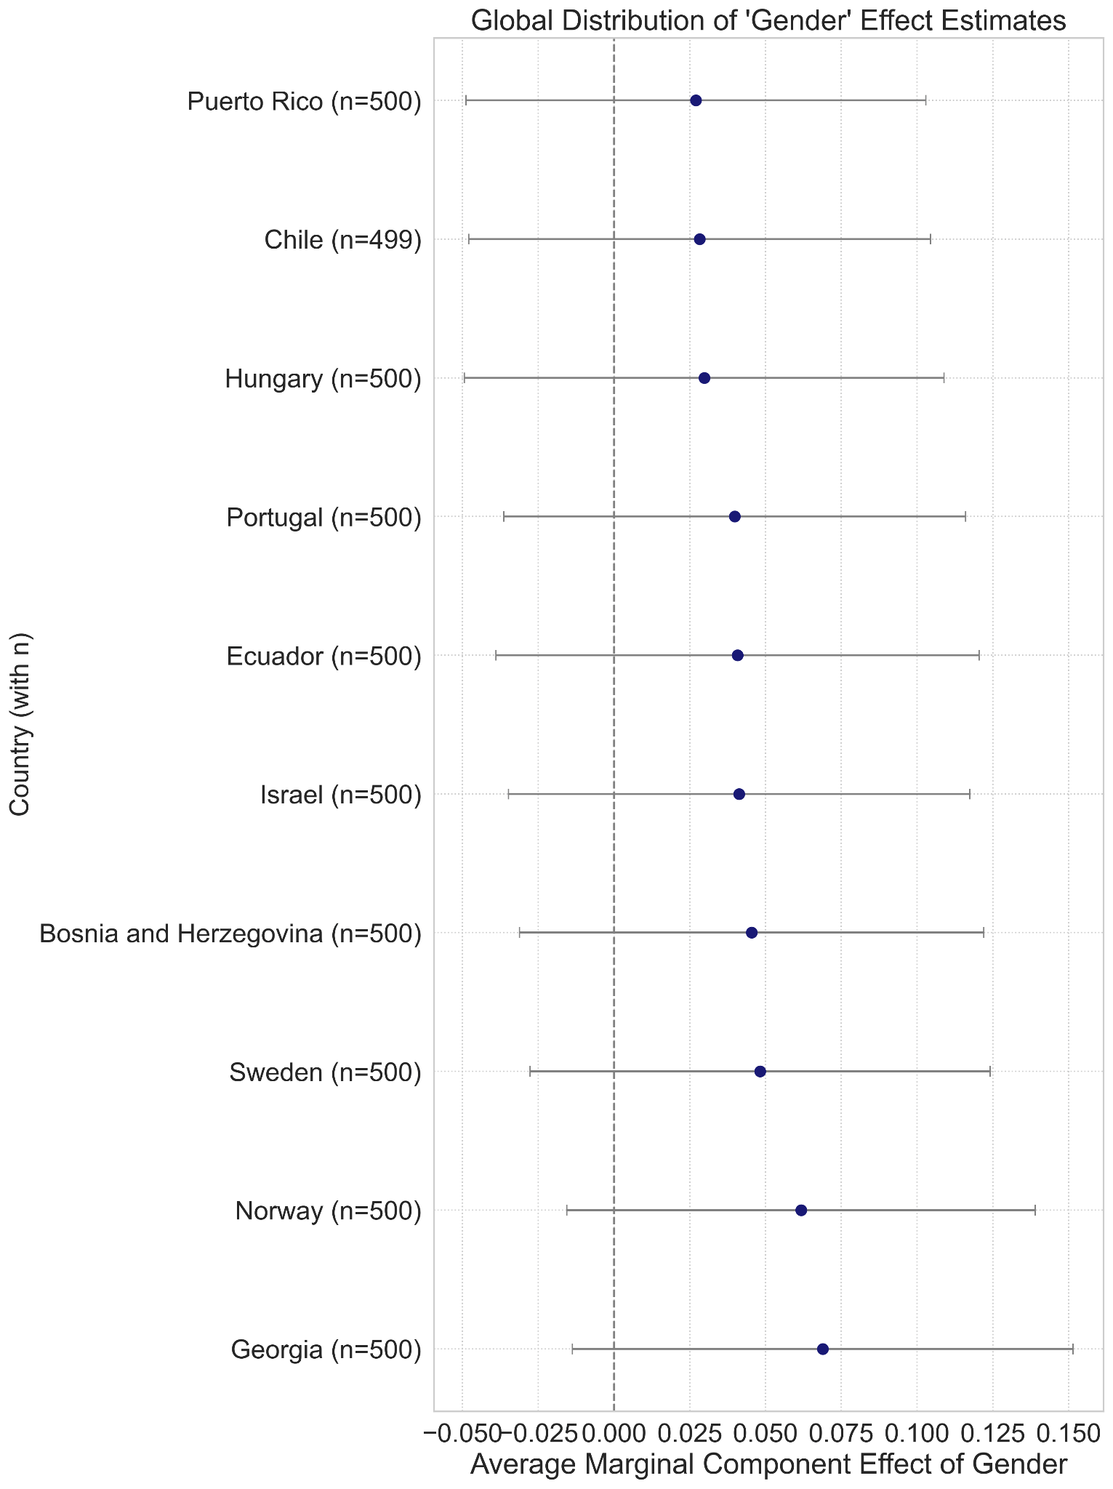
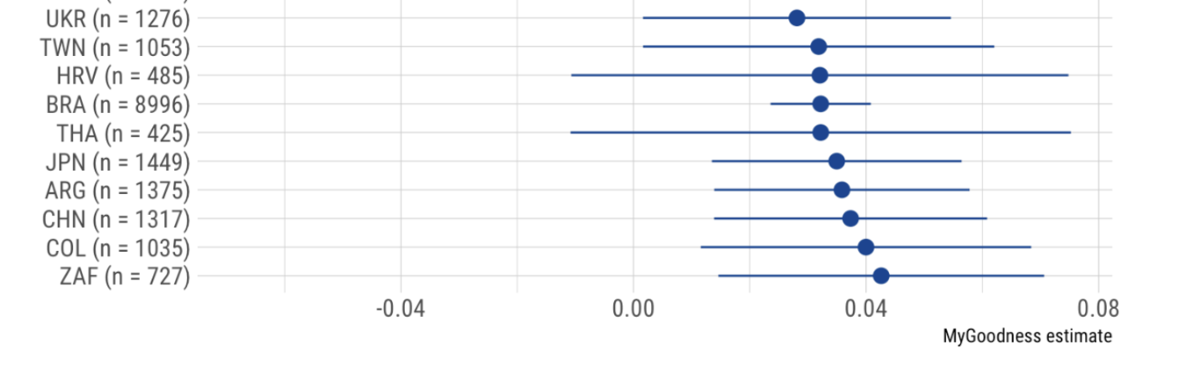
AMCE Effect of Gender
For these plots, we only consider the top 10 countries
Average probability changes are larger for the LLM decisions compared to human decisions (7.5%, 4%)
Gender is more important for the LLM model
Country does not overlap. Maybe country is not a decision factor

Slide 32
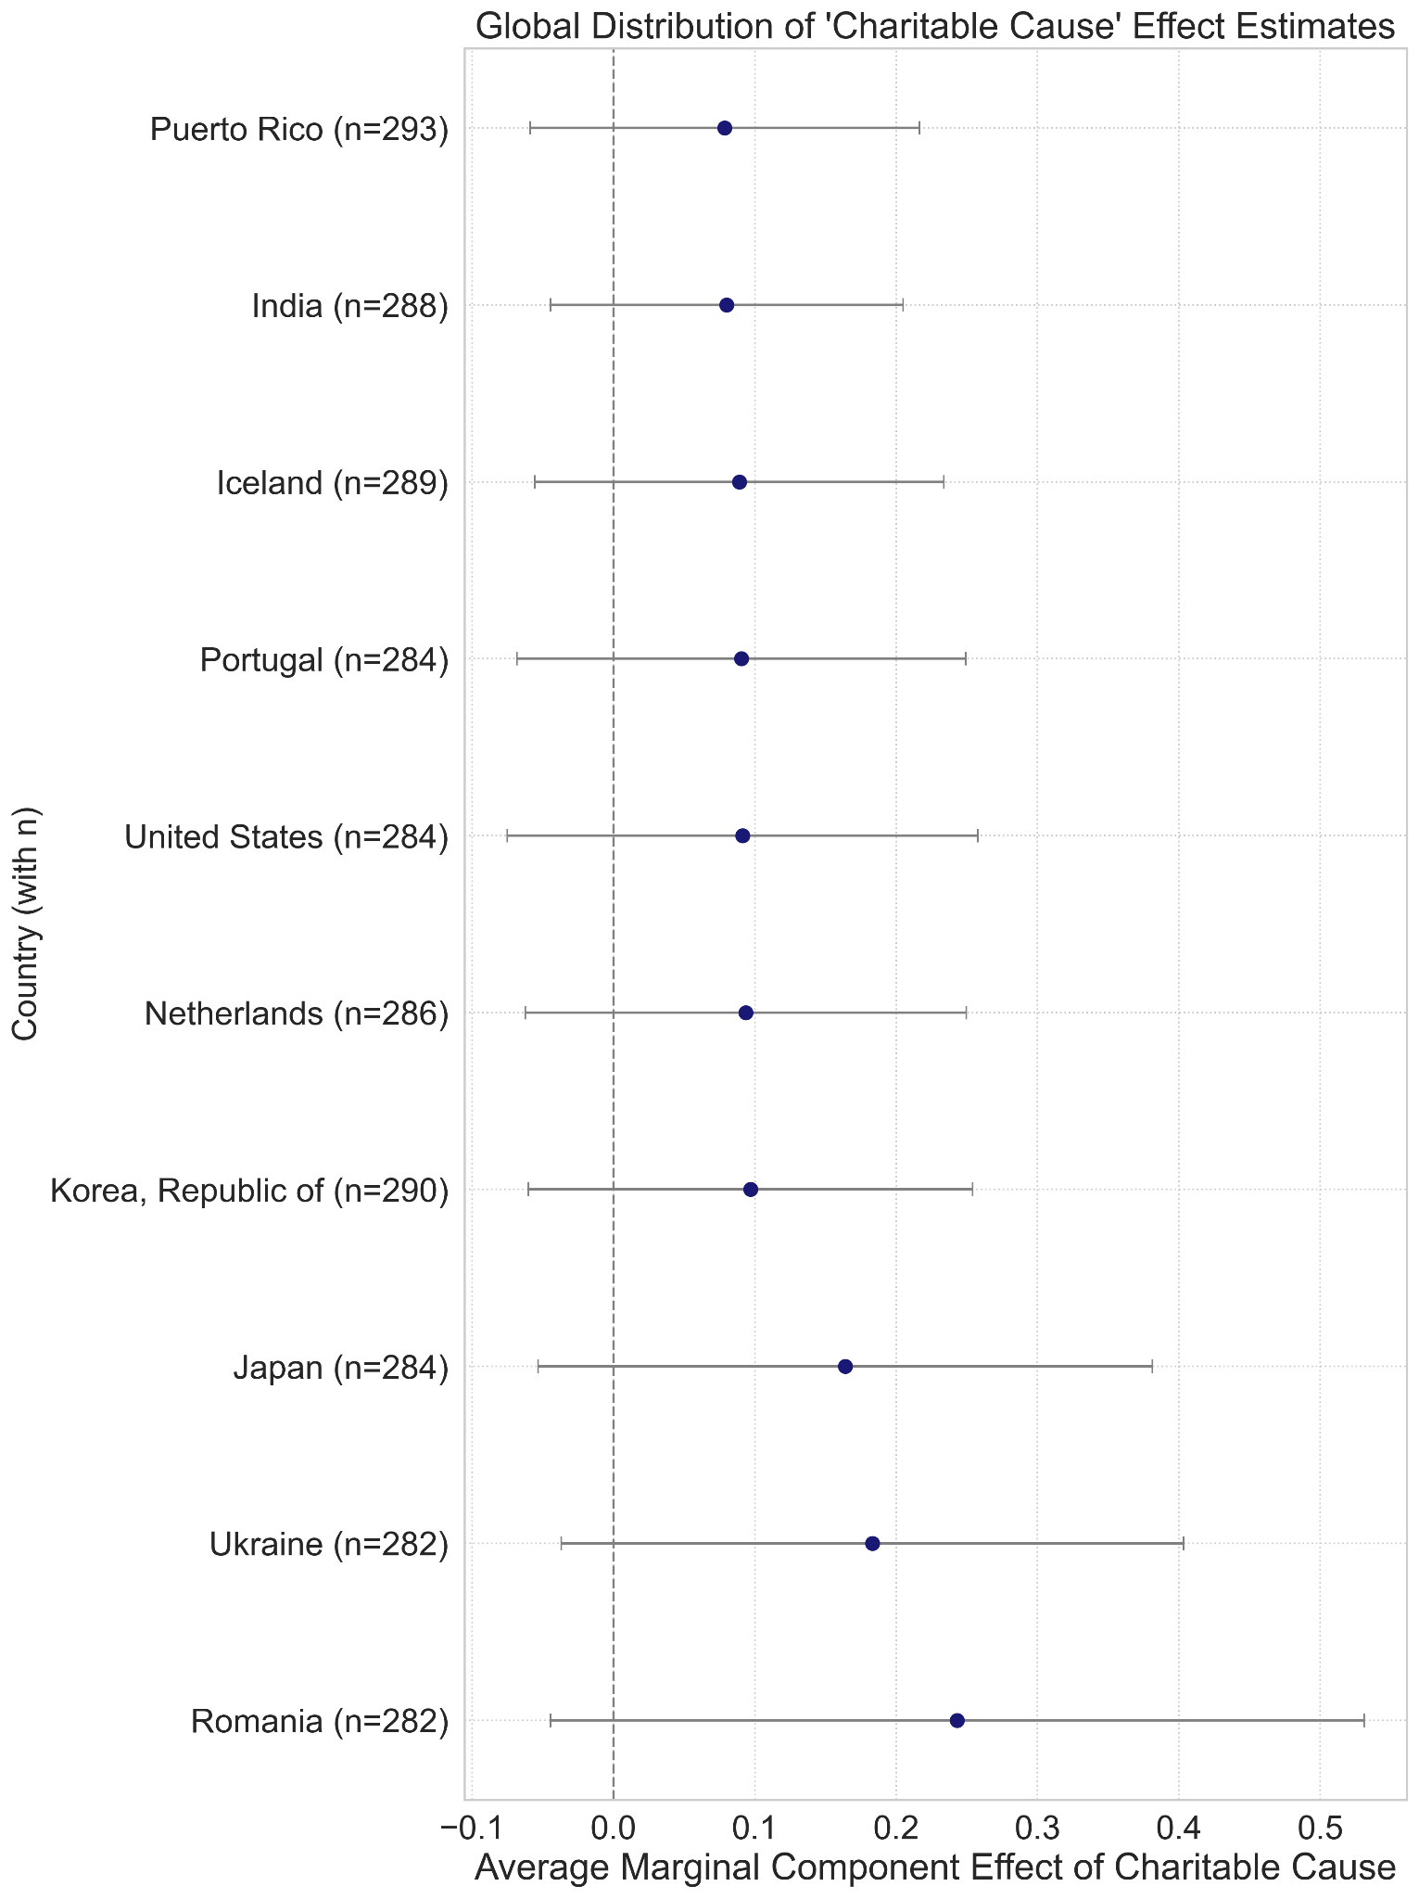
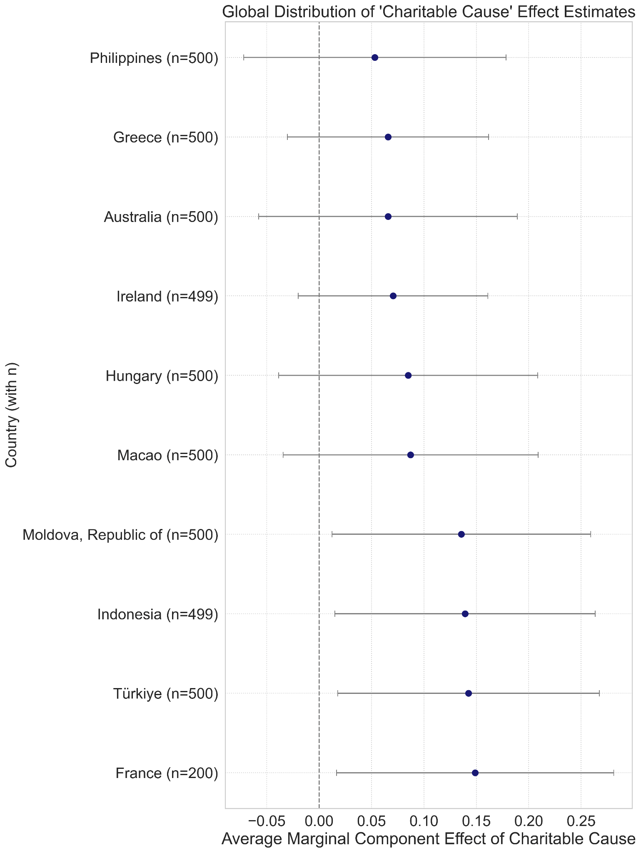
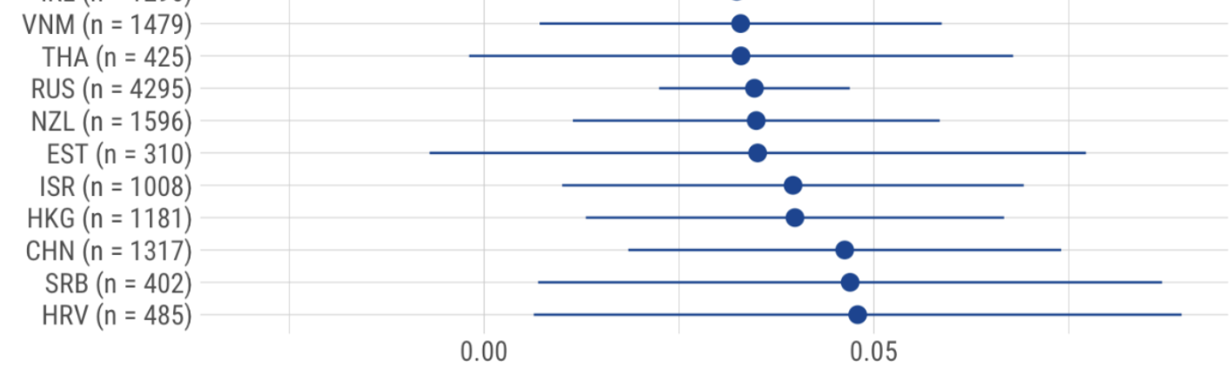
AMCE Effect of Charitable Cause
Average probability changes are larger for the LLM decisions compared to human decisions (25%, 5%)
Cause is more important factor for the LLM model
Country does not overlap. Maybe country is not a decision factor

Slide 33
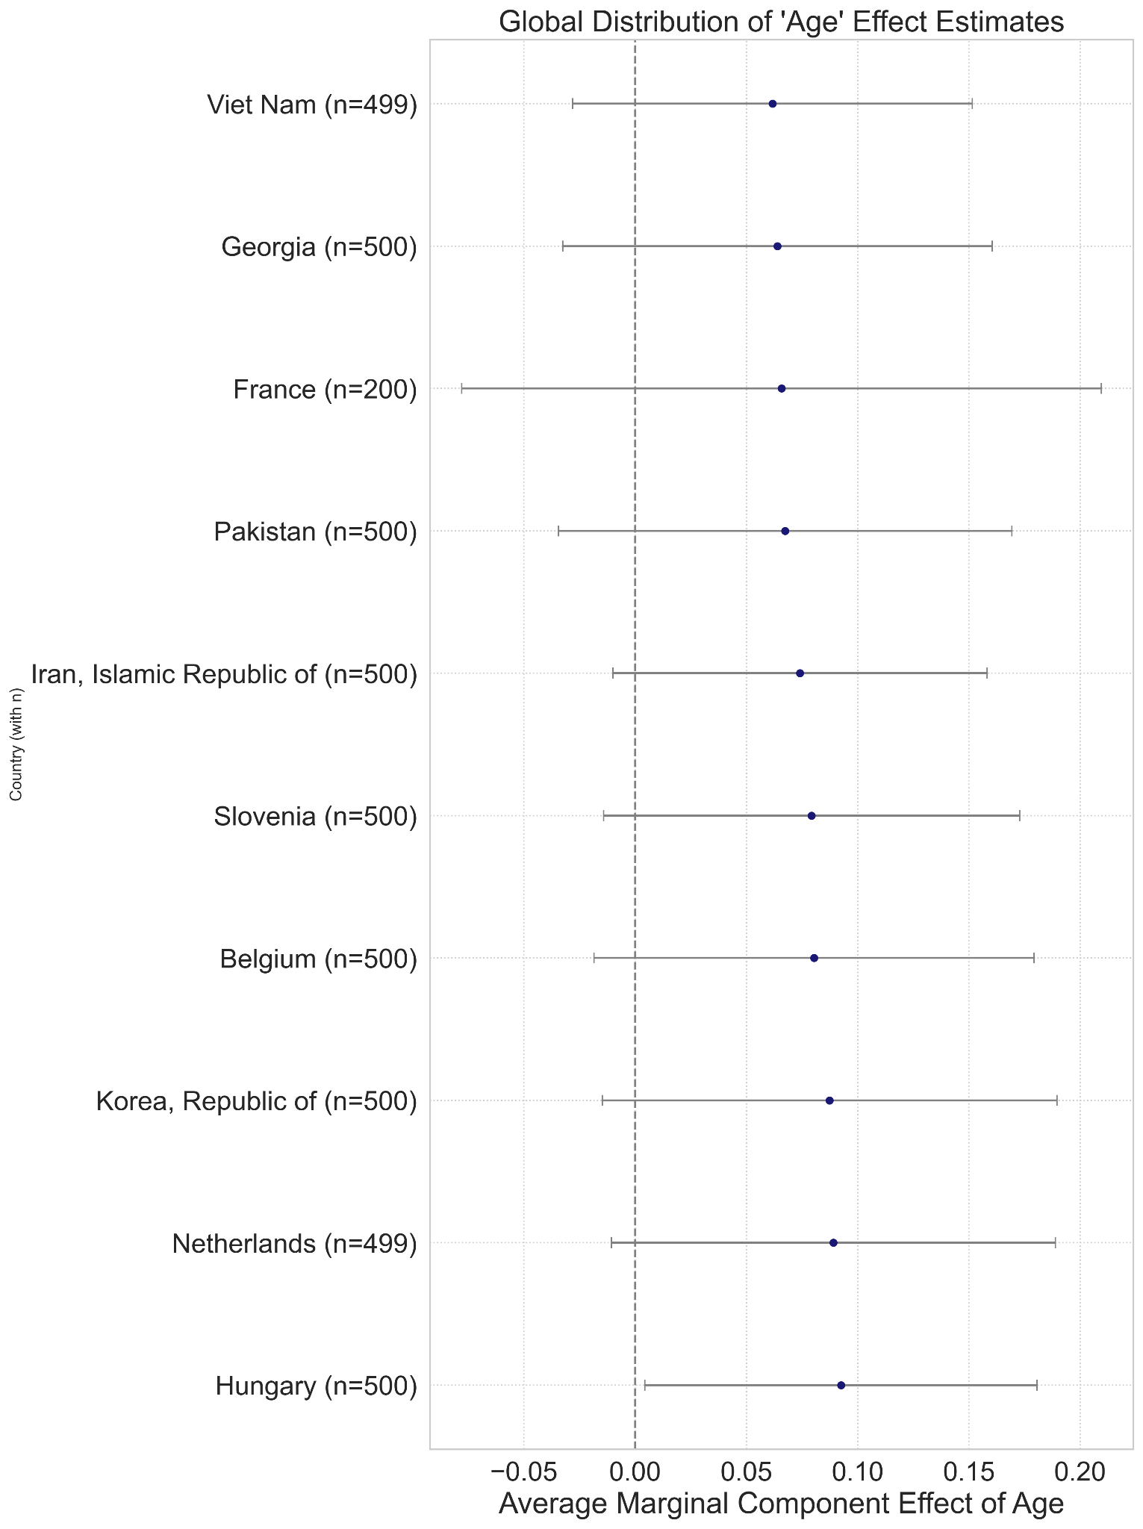
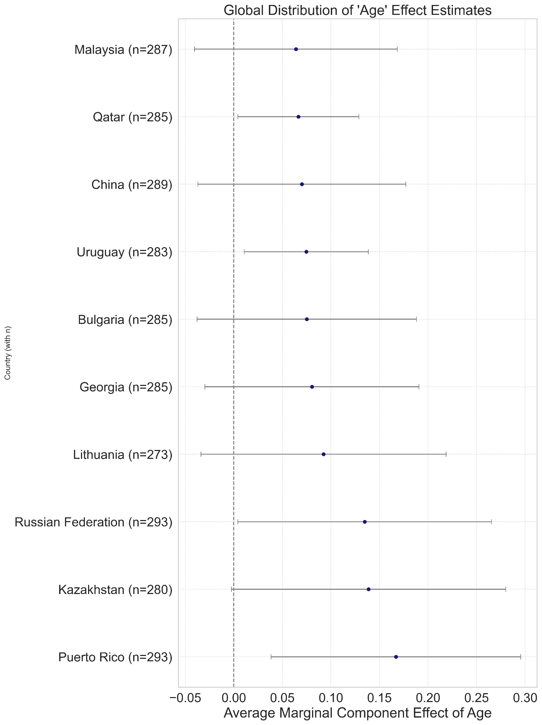
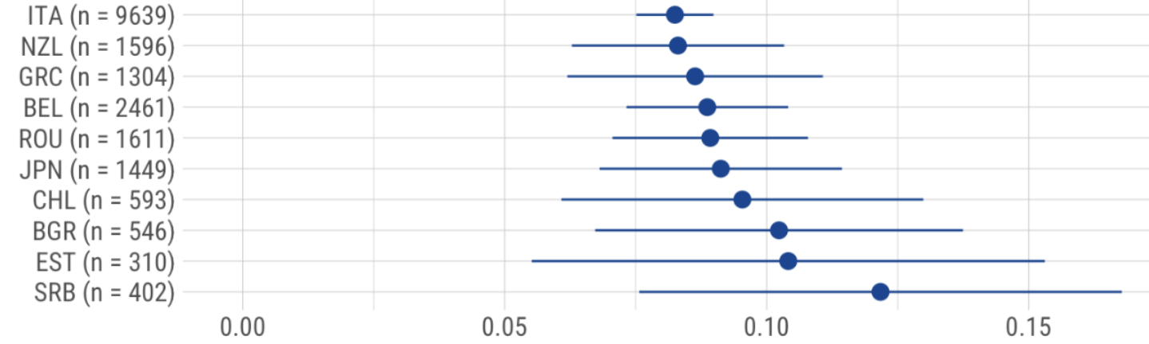
AMCE Effect of Age
Average probability changes for the LLM decisions are compared to human decisions (12%, 12%)
LLM decisions considers Age factor similar to human decisions
Country does not overlap. Maybe country is not a decision factor

Slide 34
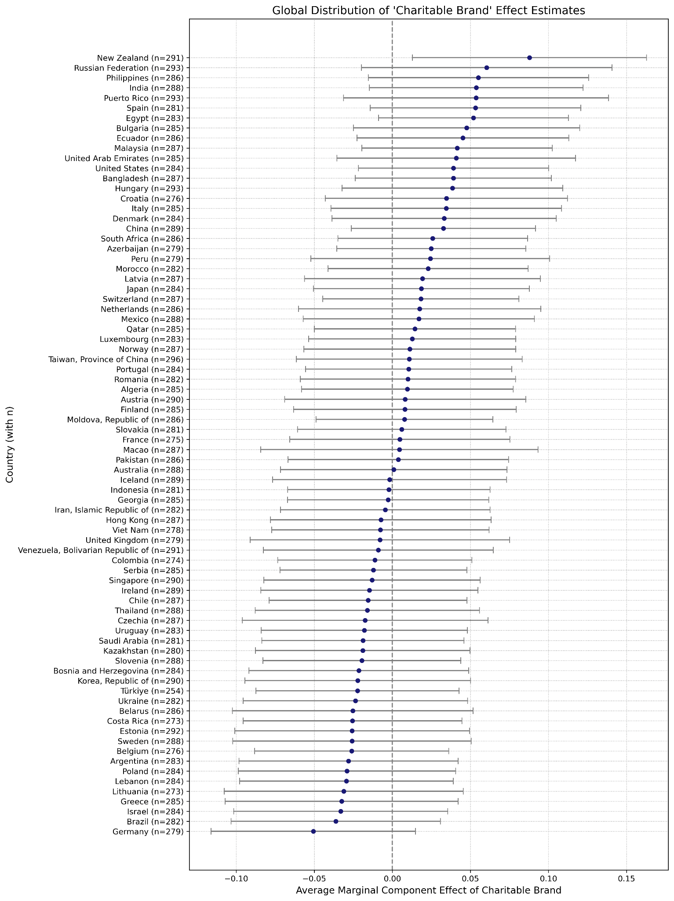
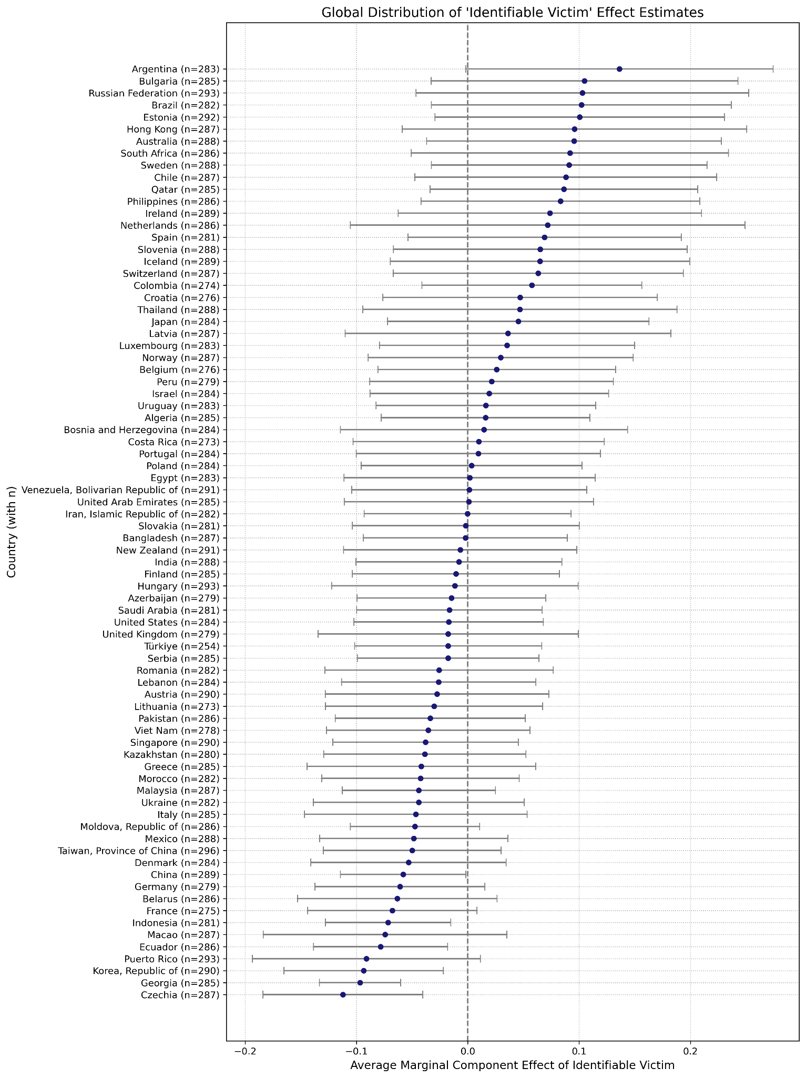

Slide 35
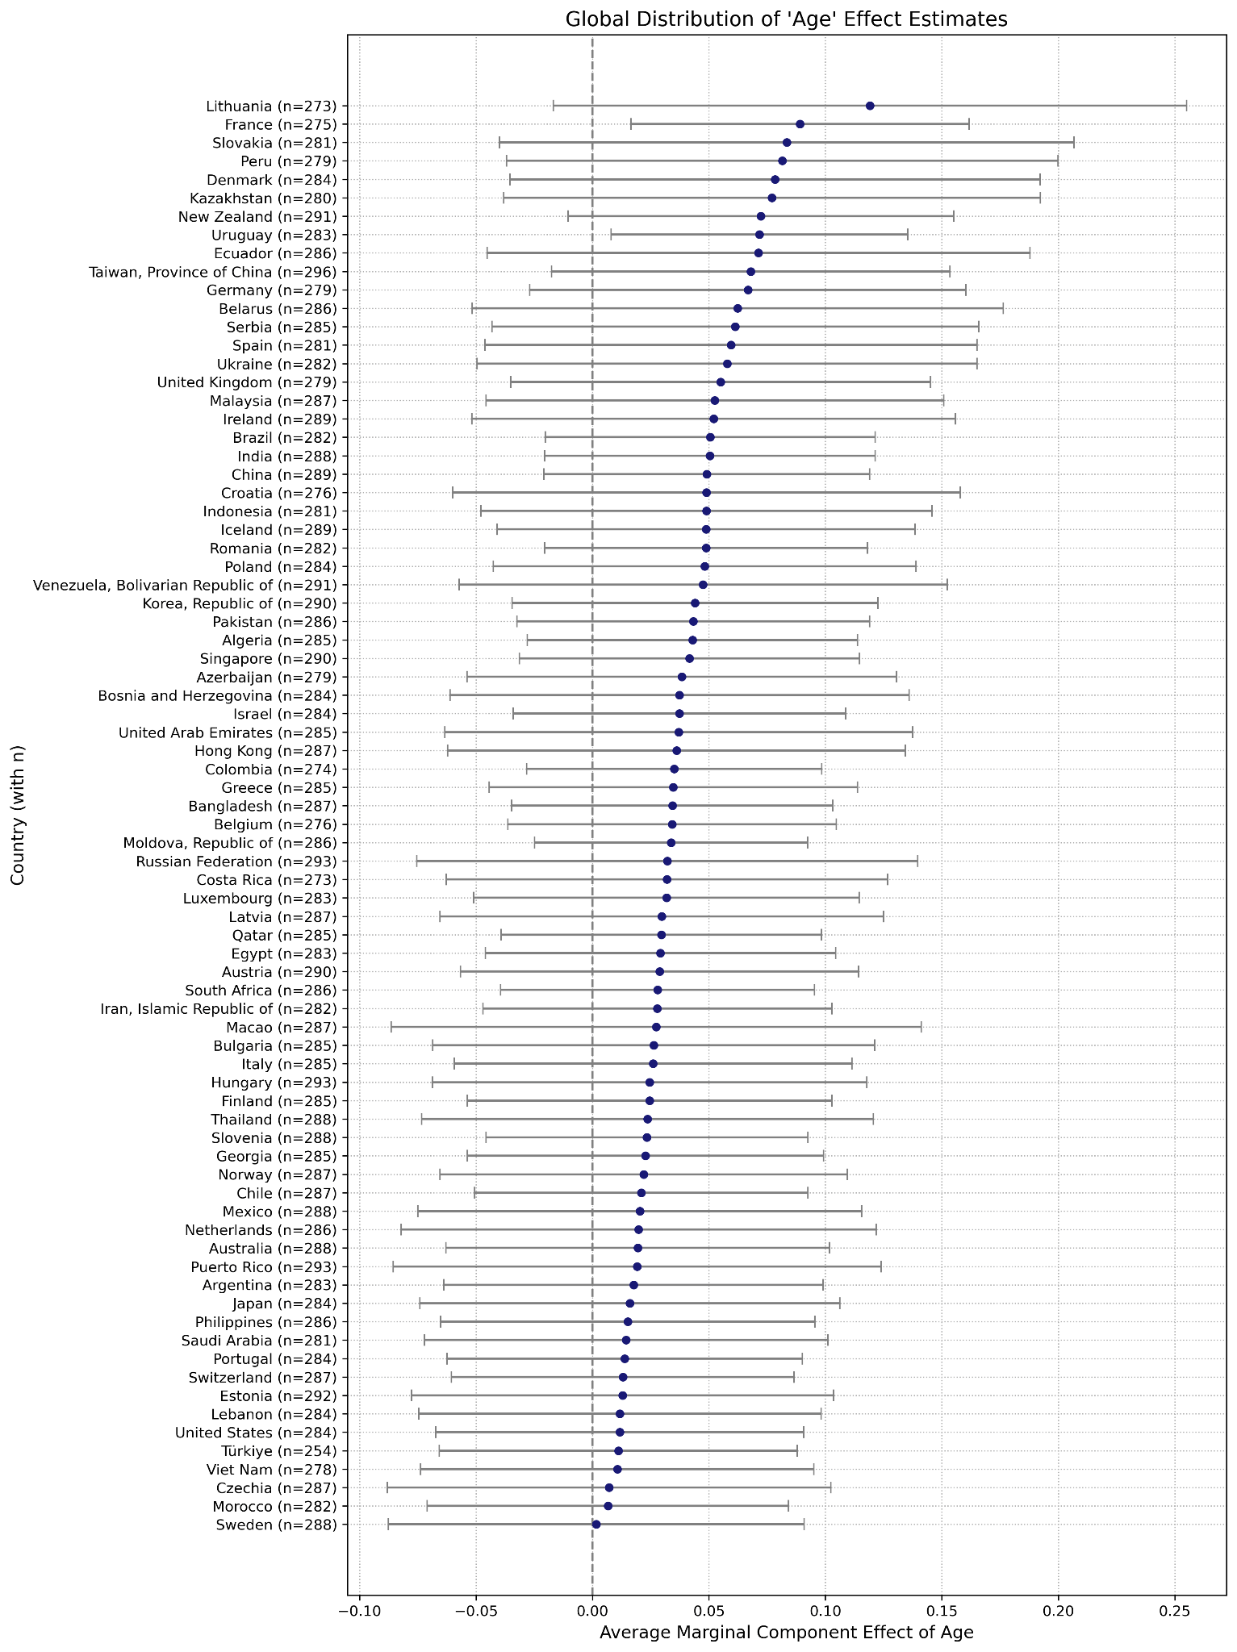
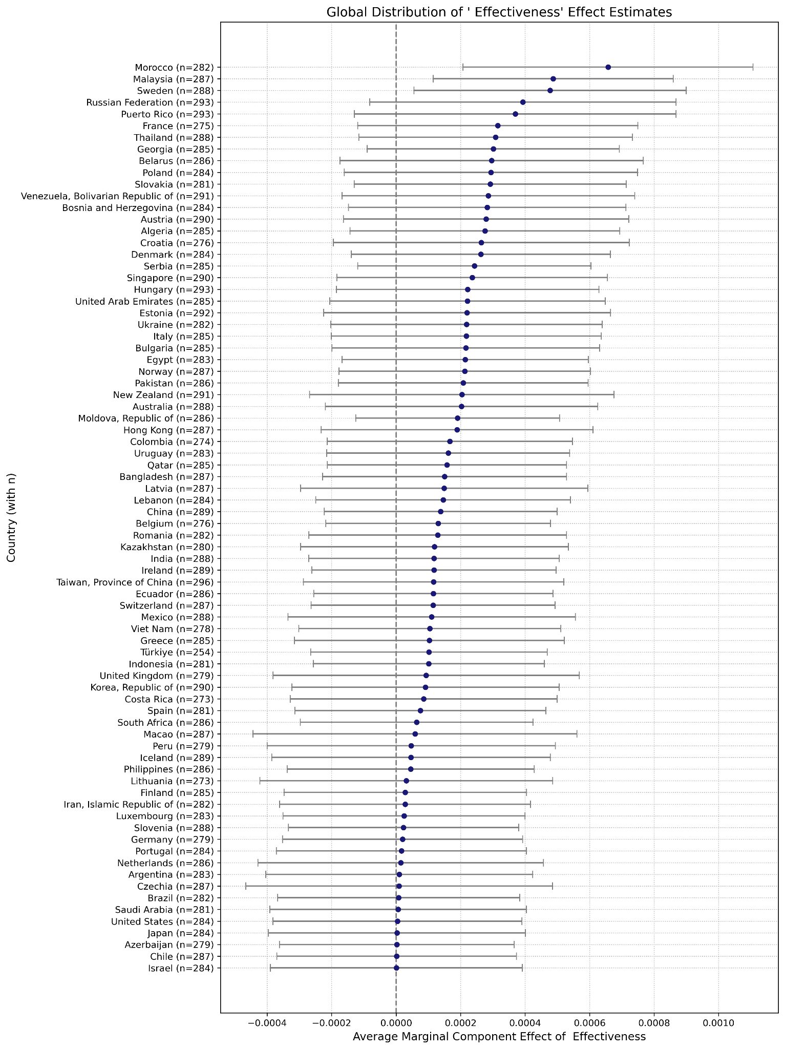

Slide 36
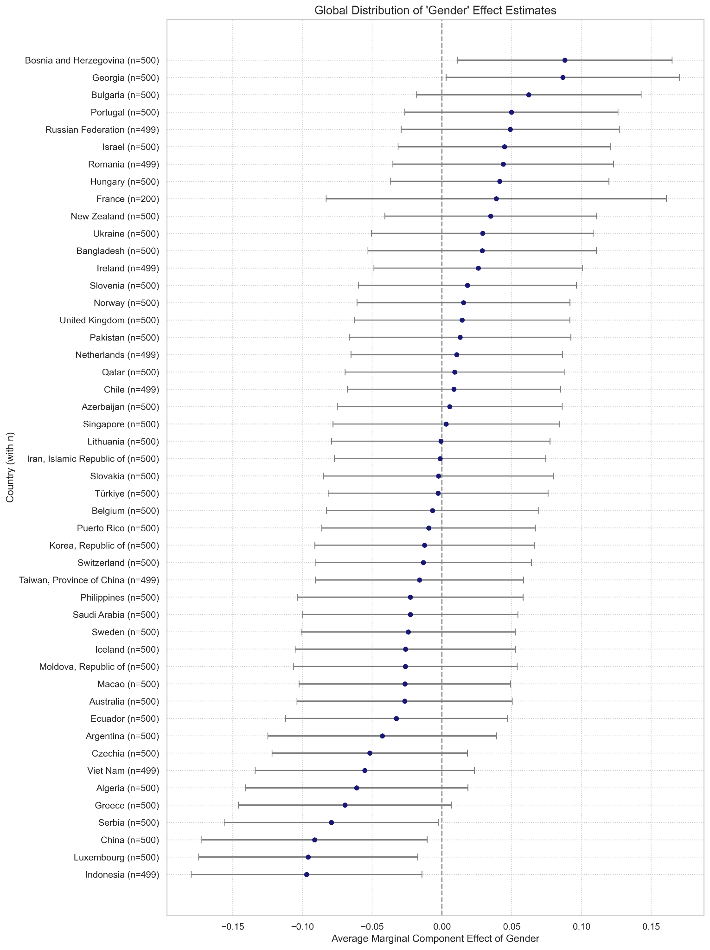
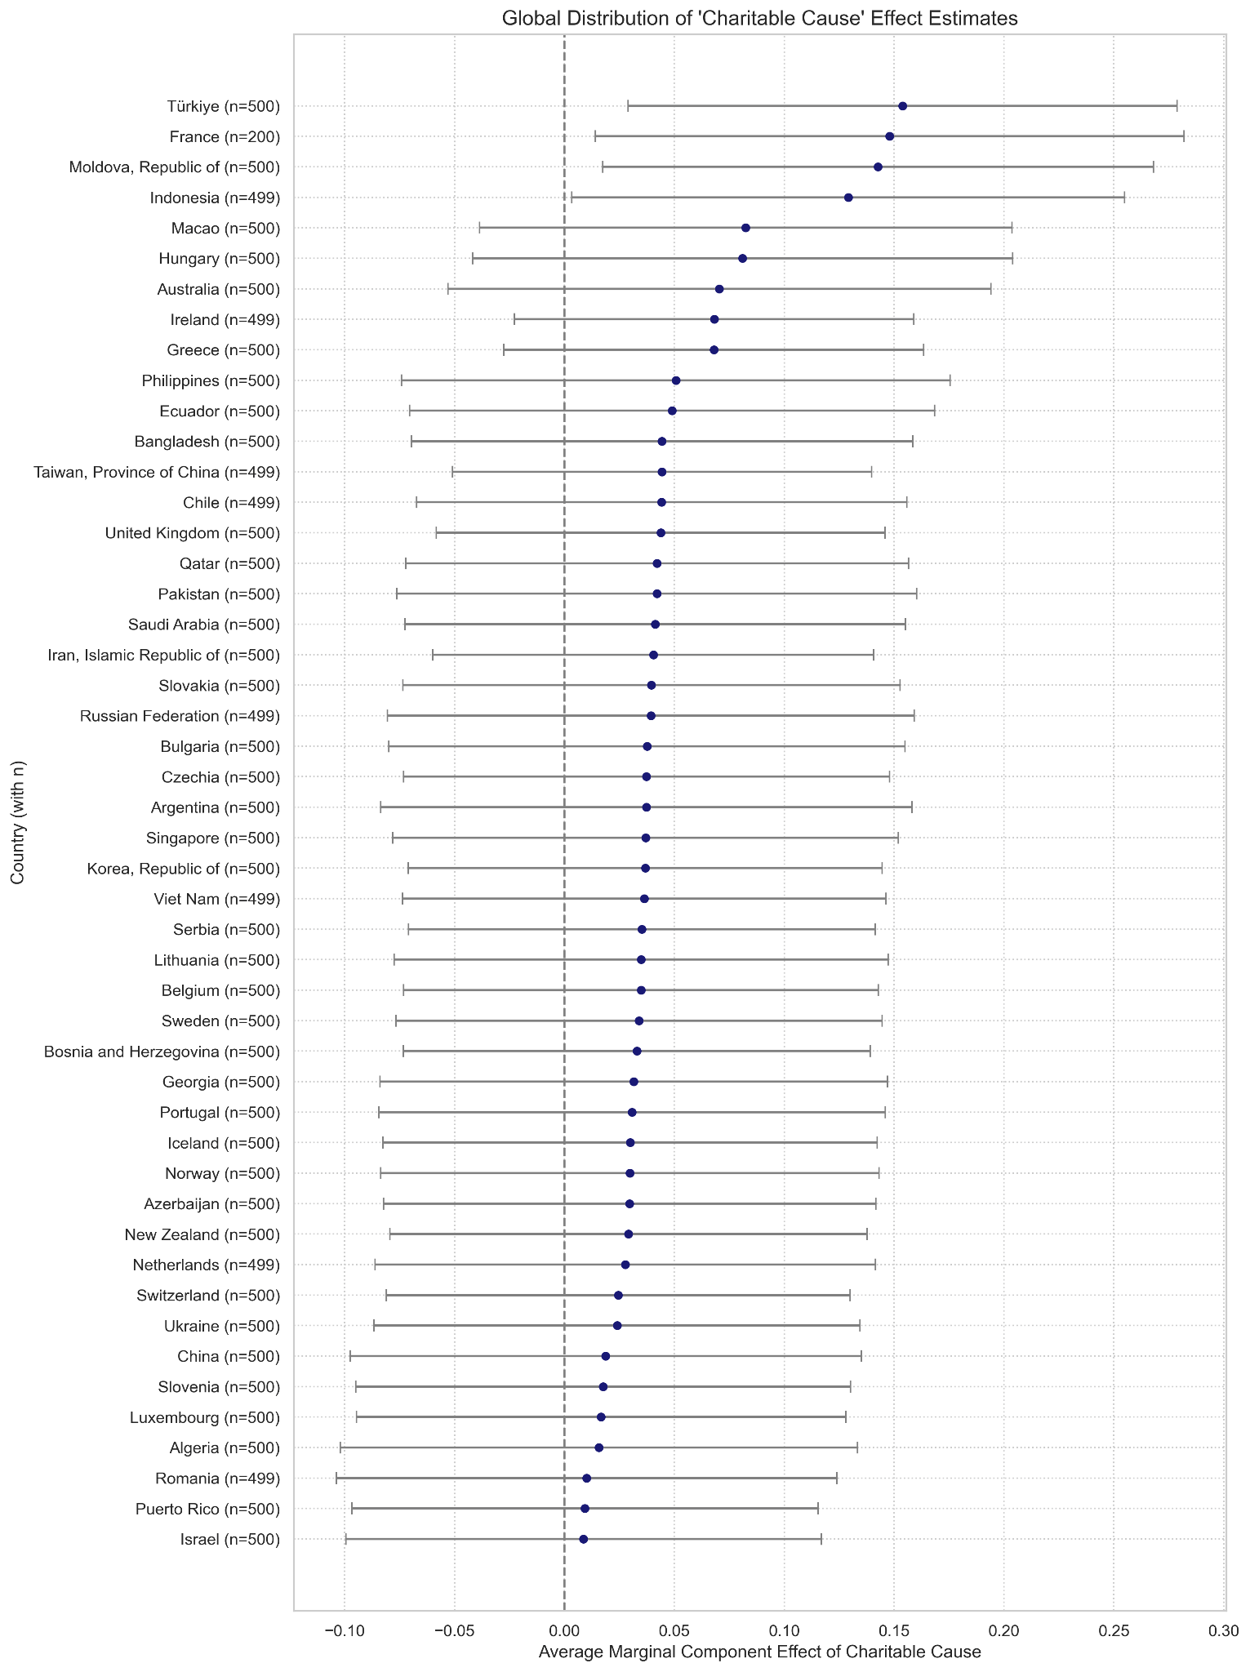

Slide 37
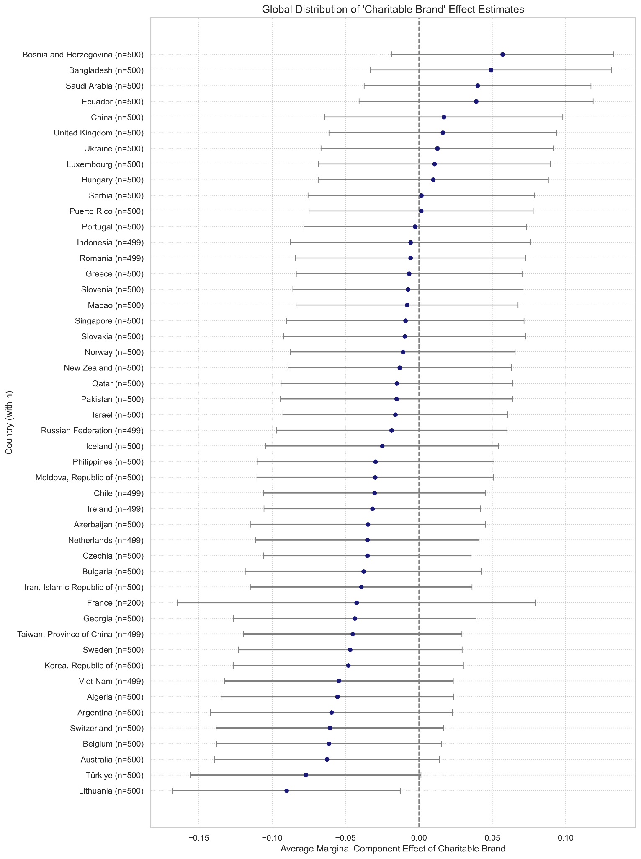
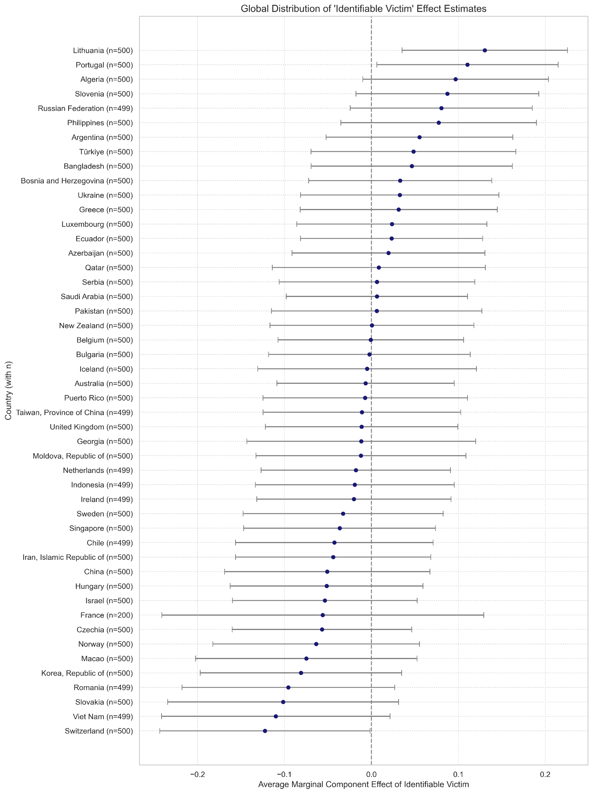

Slide 38
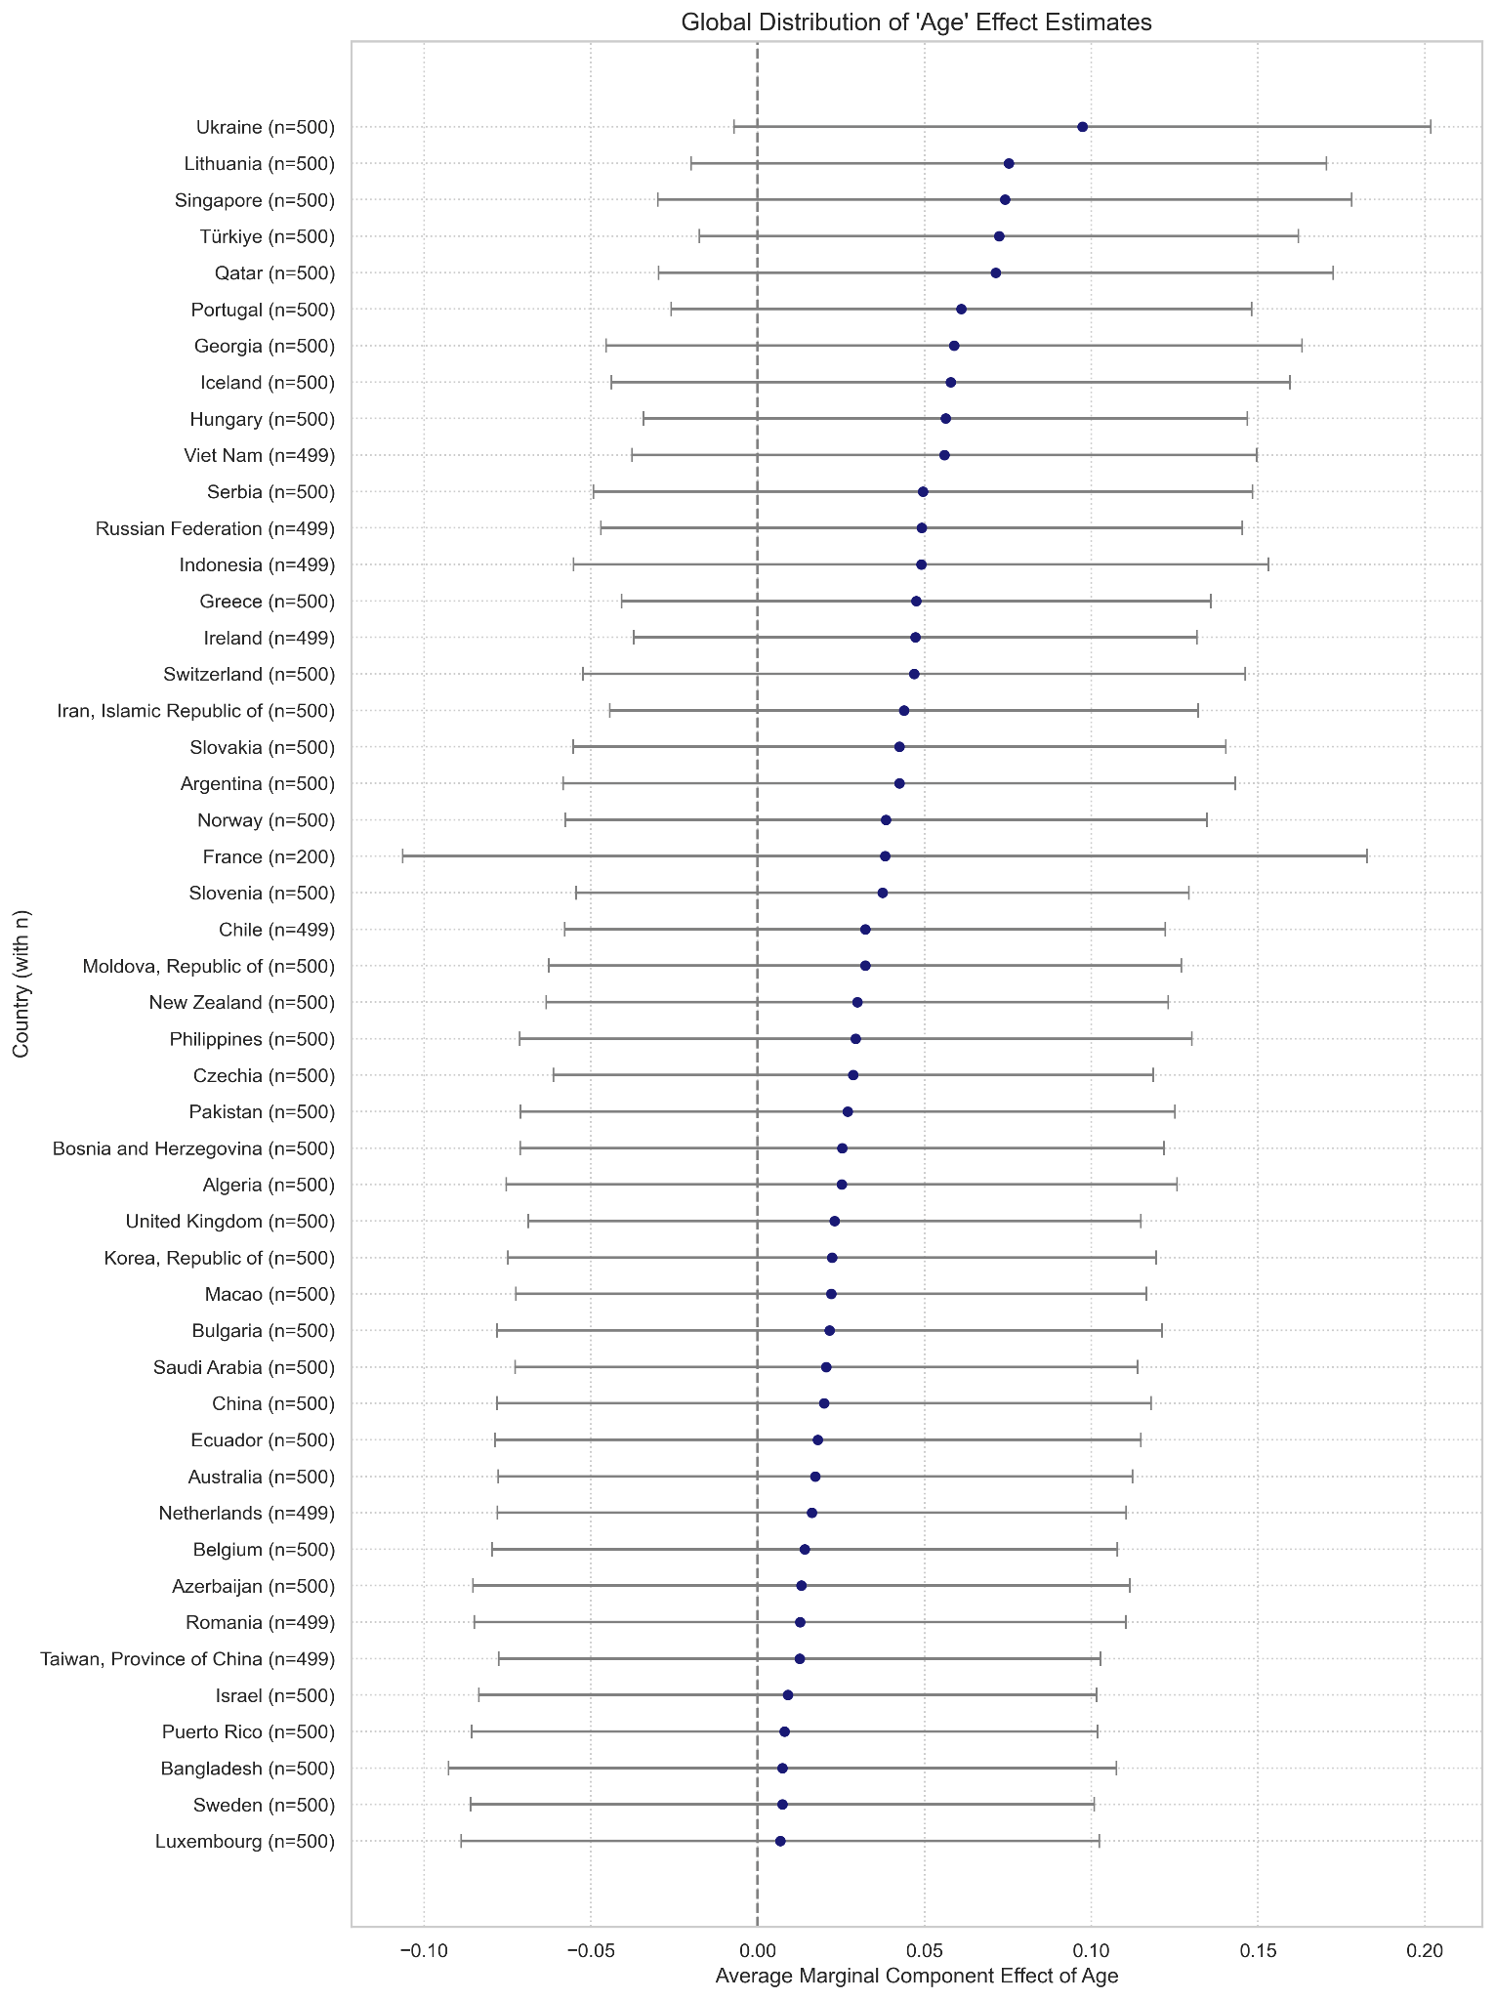
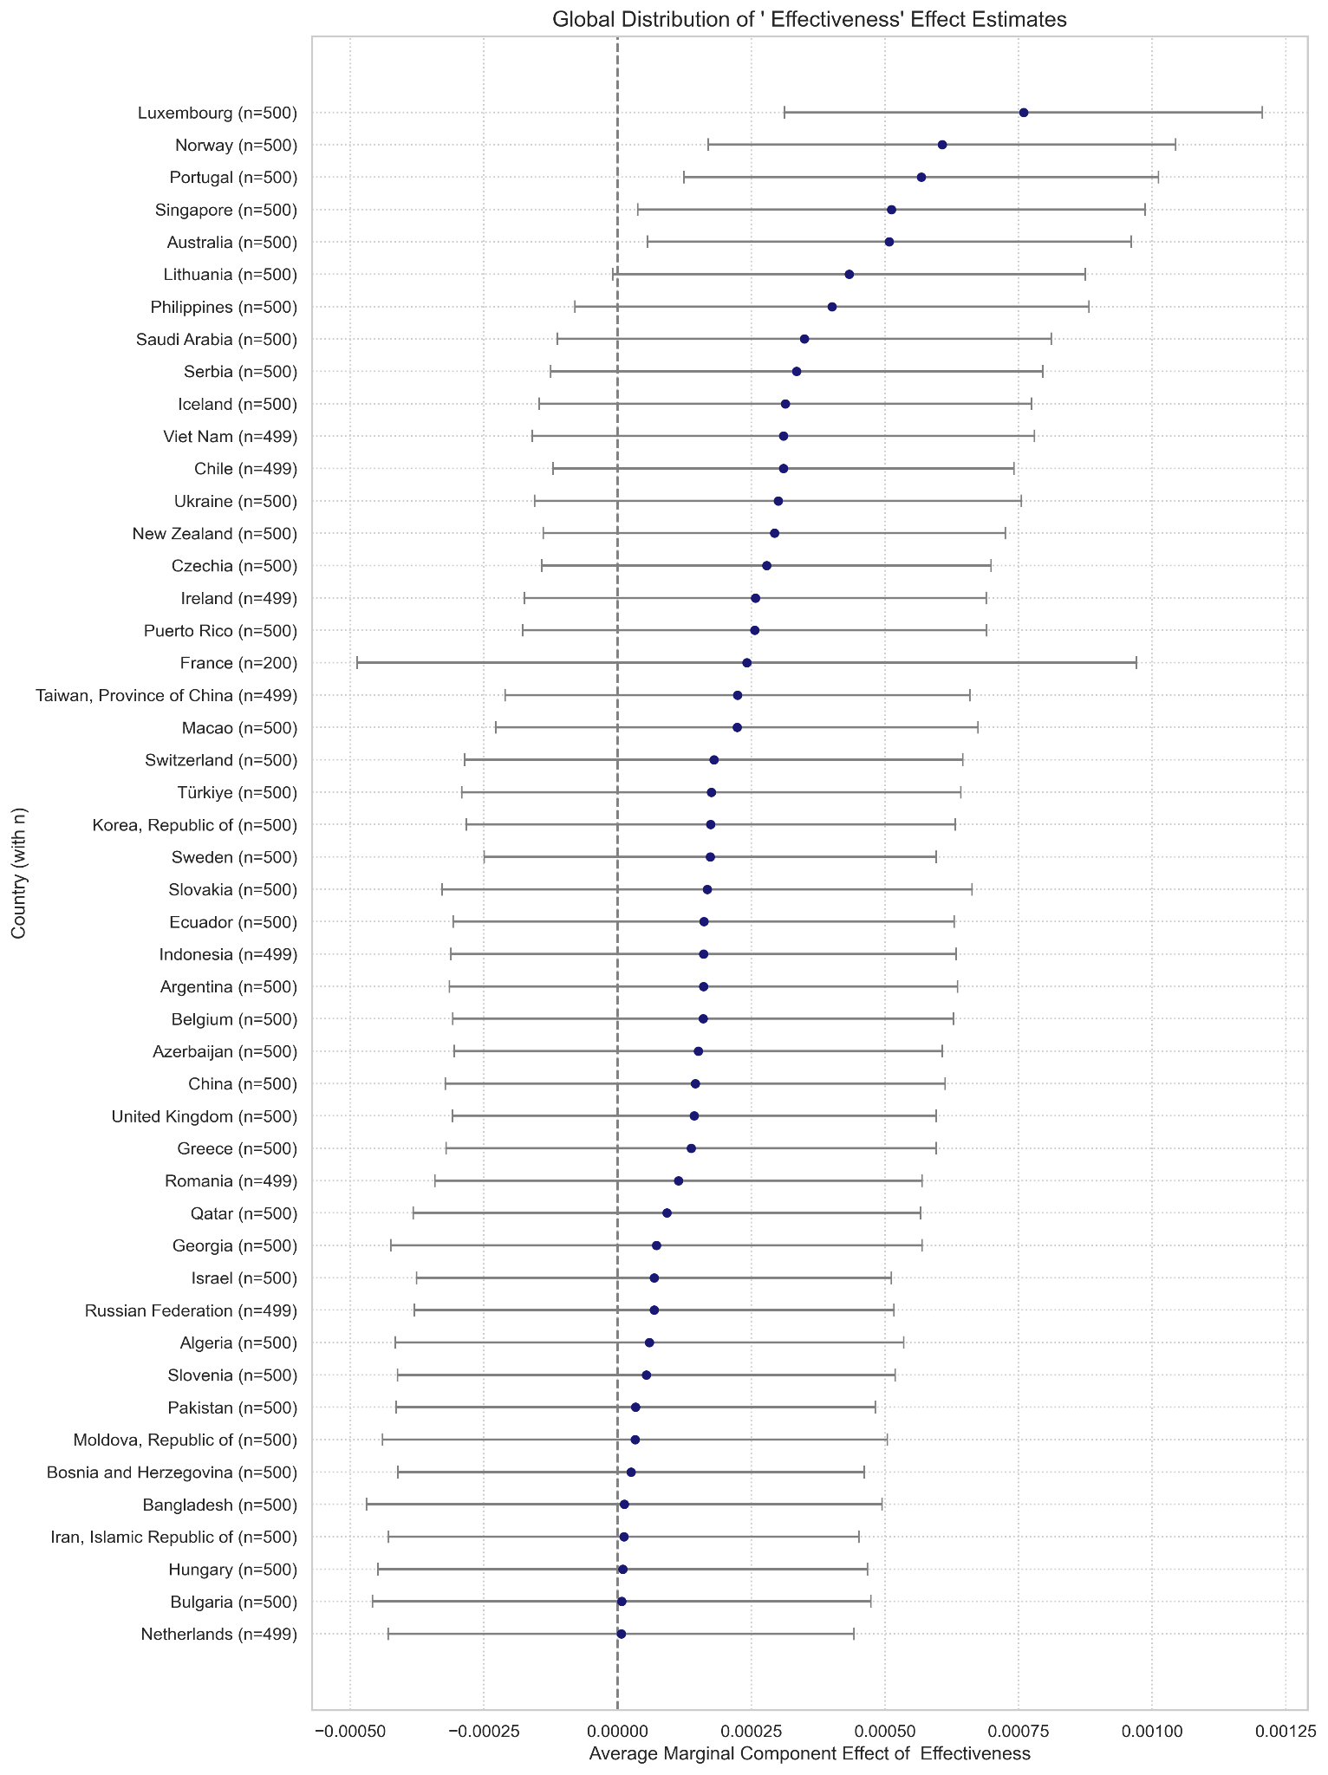

Slide 39
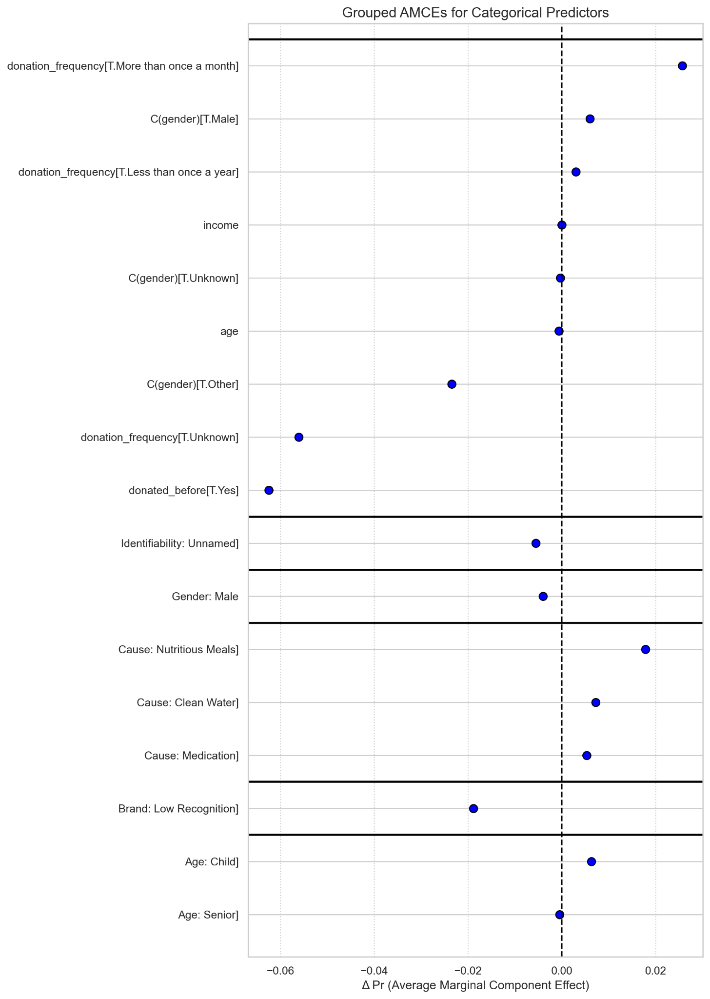

Slide 40
Conclusion:
Used LLM (OpenChat-3.5 LLaMA-3 Instruct (8B)) to generate Charitable decision
Implemented AMCE to analyse the impact of the factors on charitable decision
Factors like gender and donation cause are more important for LLM
Impact of factor age is similar for both human and LLM

Slide 41
References:
Awad, E., Yoeli, E., Rahwan, I., & Rahwan, Z. (2024, September 12). Heterogeneity in charitable giving preferences from over 2 million decisions worldwide. https://doi.org/10.31219/osf.io/28g3z
AI@Meta. (2024). Llama 3 model card. https://github.com/meta-llama/llama3/blob/main/MODEL_CARD.md
Meta. (2024). Meta Llama 3 8B Instruct [Large language model]. Hugging Face. https://huggingface.co/meta-llama/Meta-Llama-3-8B-Instruct
Wang, G., Cheng, S., Zhan, X., Li, X., Song, S., & Liu, Y. (2023). OpenChat: Advancing open-source language models with mixed-quality data (arXiv preprint arXiv:2309.11235). arXiv. https://arxiv.org/abs/2309.11235
OpenChat. (2024). OpenChat 3.6 8B (2024-05-22) [Large language model]. Hugging Face. https://huggingface.co/openchat/openchat-3.6-8b-20240522

